Slide 1
The Catholic Life of St John’s School 2022/2023

Slide 2
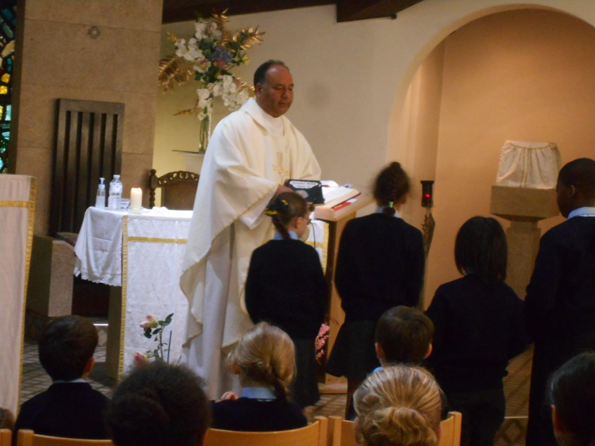
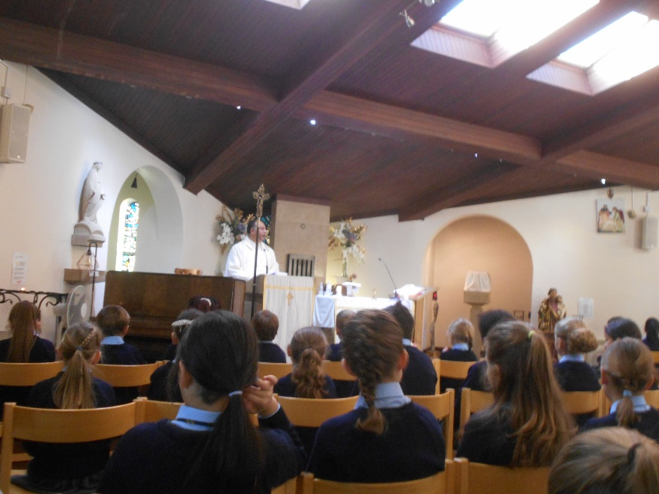
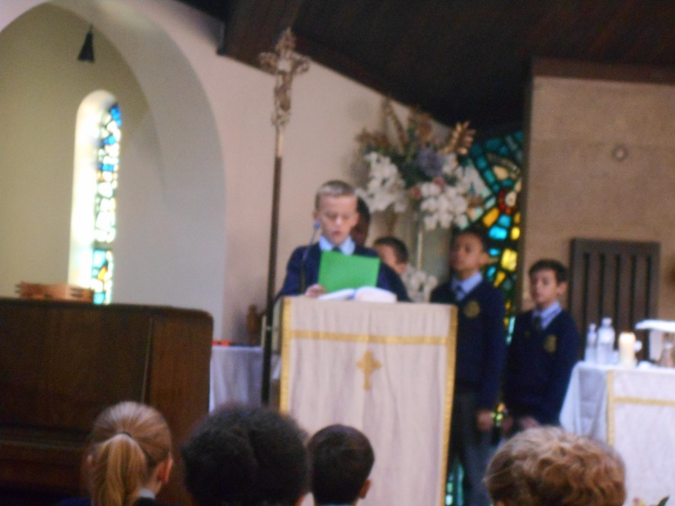
Start of the School Year Mass
The KS2 children joined with the parish community to celebrate a special mass to mark the beginning of the academic year.

Slide 3
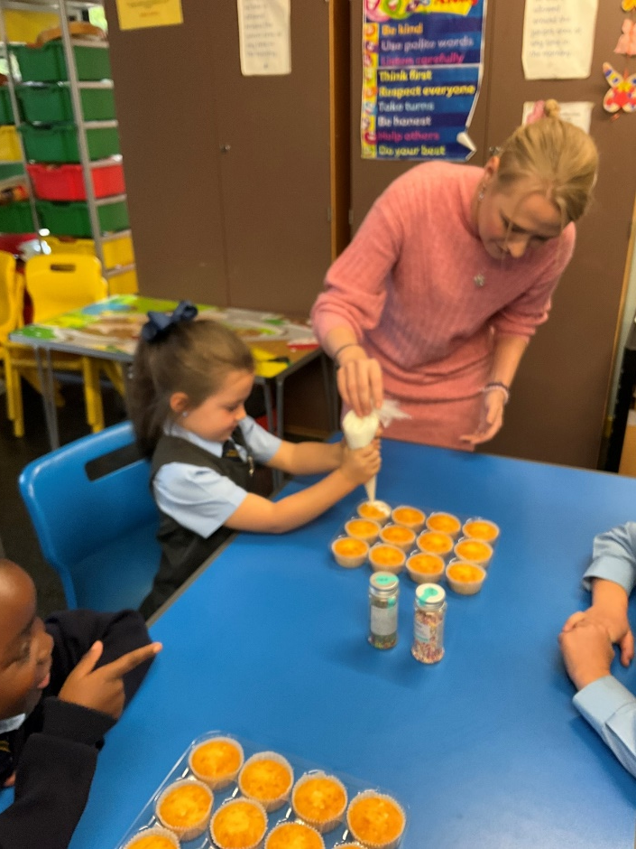
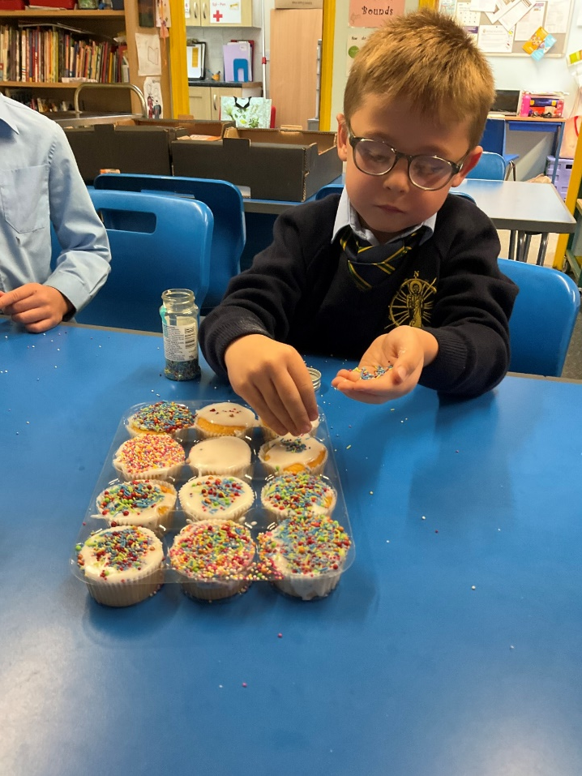
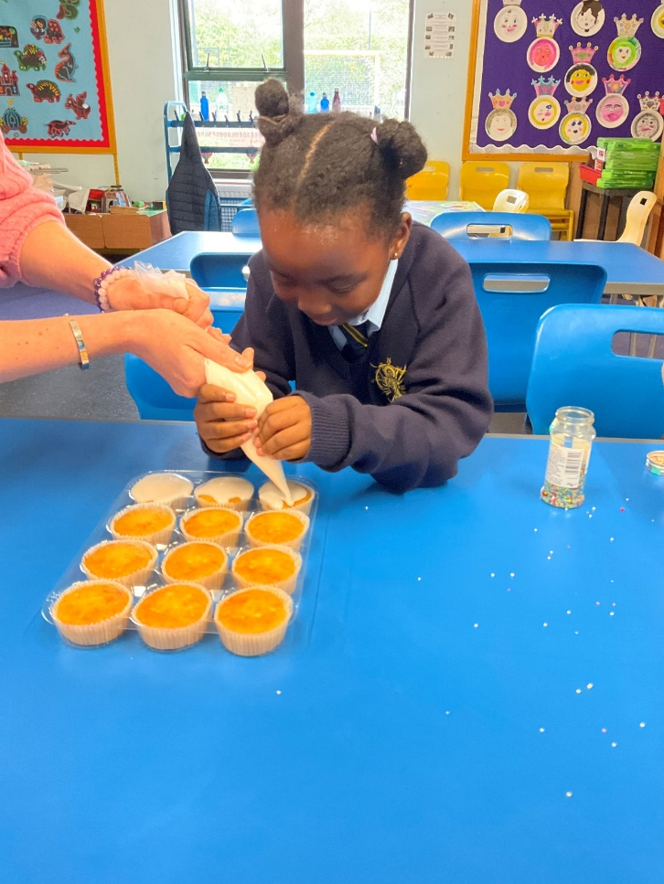
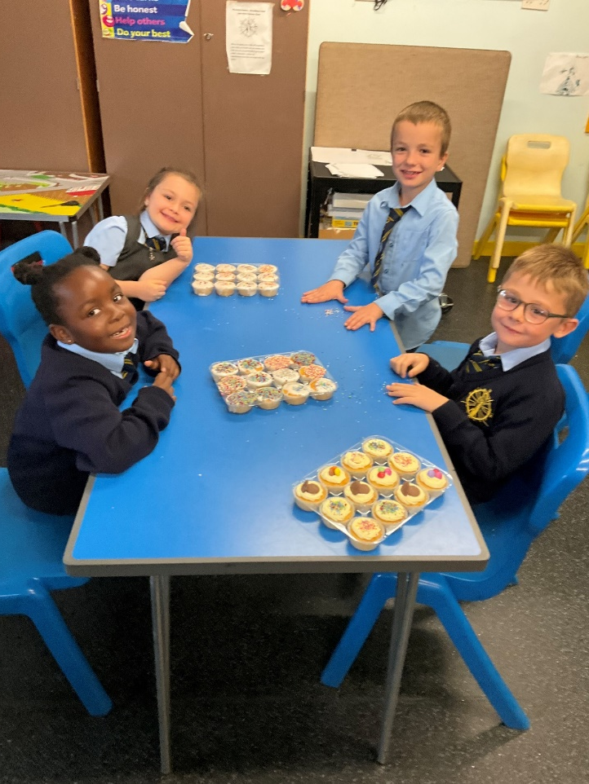
Floods in Pakistan - Cake sale 5th October
Raising money to help the victims of the floods in Pakistan. This is a cause very close to the heart of Fr Azad. We raised over £100 which we donated via DEC.

Slide 4
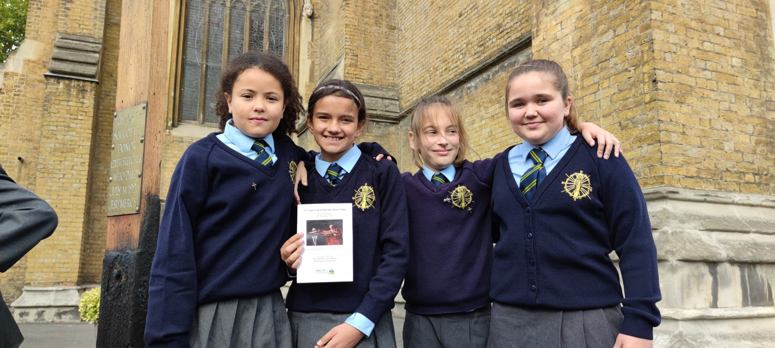
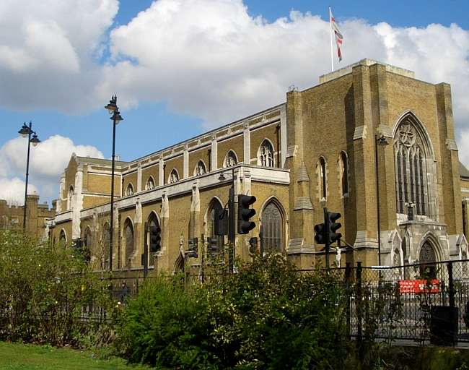
Mass at St George’s Cathedral
Our Year 5 and Year 6 Catholic Life Committee members represented the school at St George’s Cathedral for a special mass to commemorate the beginning of the Academic Year. There were small groups of children from many, many schools. Archbishop John Wilson, was chief celebrant with Fr Victor Darlington assisting amongst others. The atmosphere was very special and we were delighted to be able to share in this event.

Slide 5
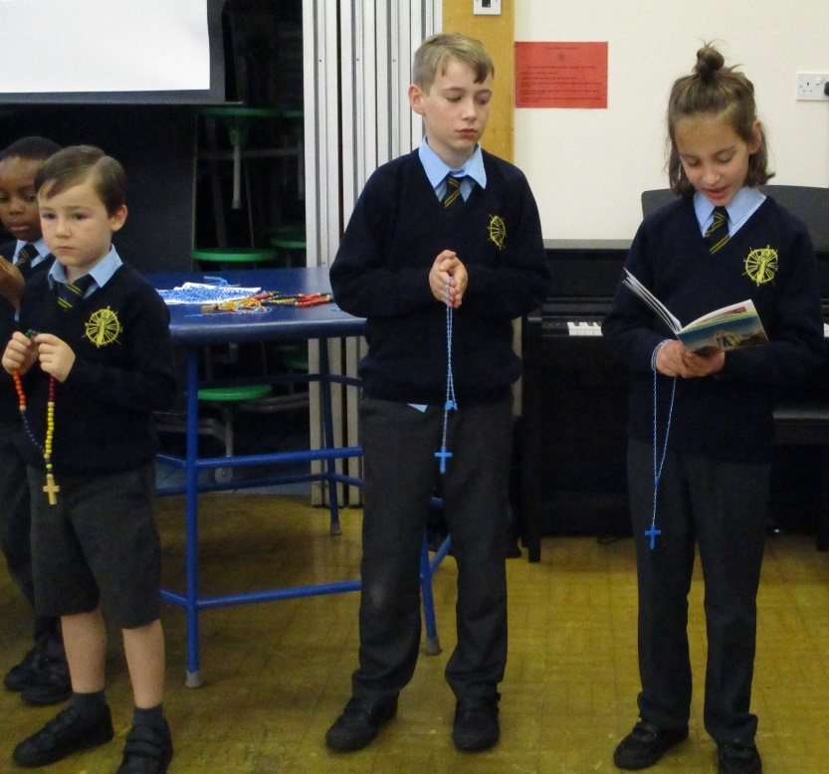
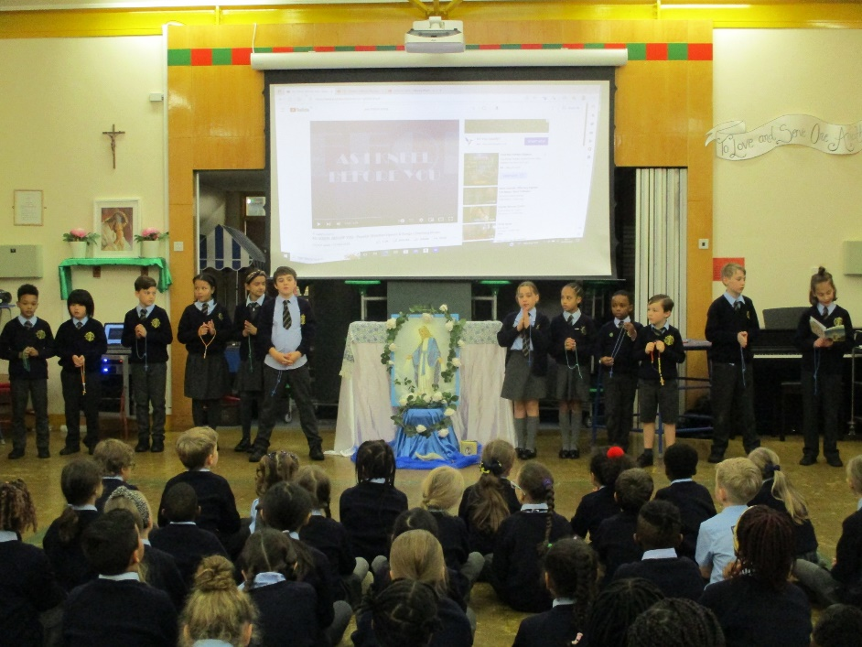
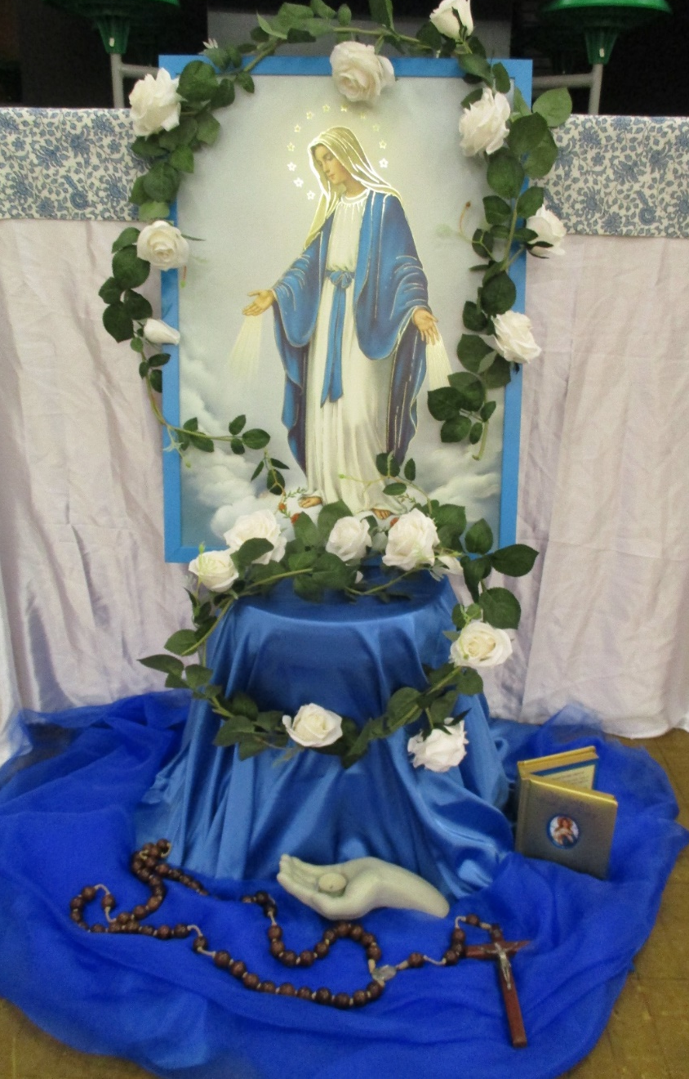
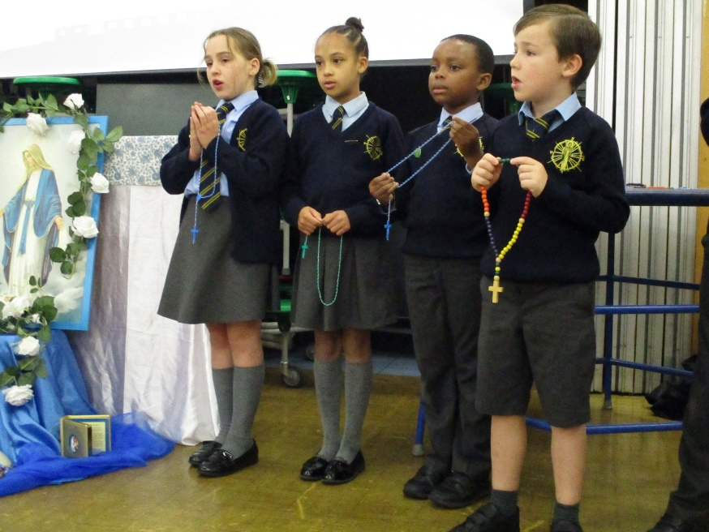
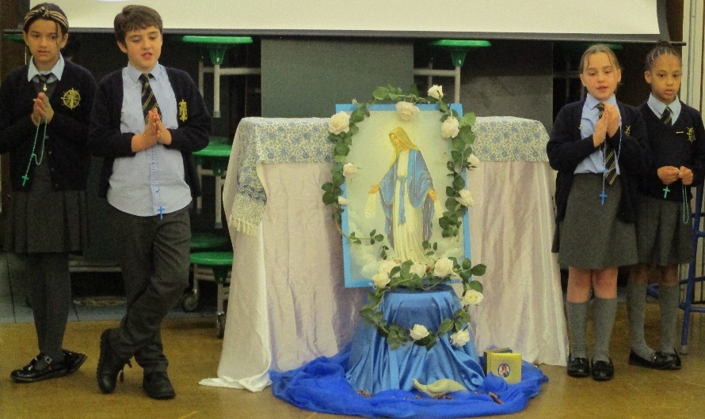
The Month of October
October is known as the month of the rosary and we mark this in a special way in school. The children are encouraged to pray a decade of the rosary at various times to remember the life of Mary.

Slide 6
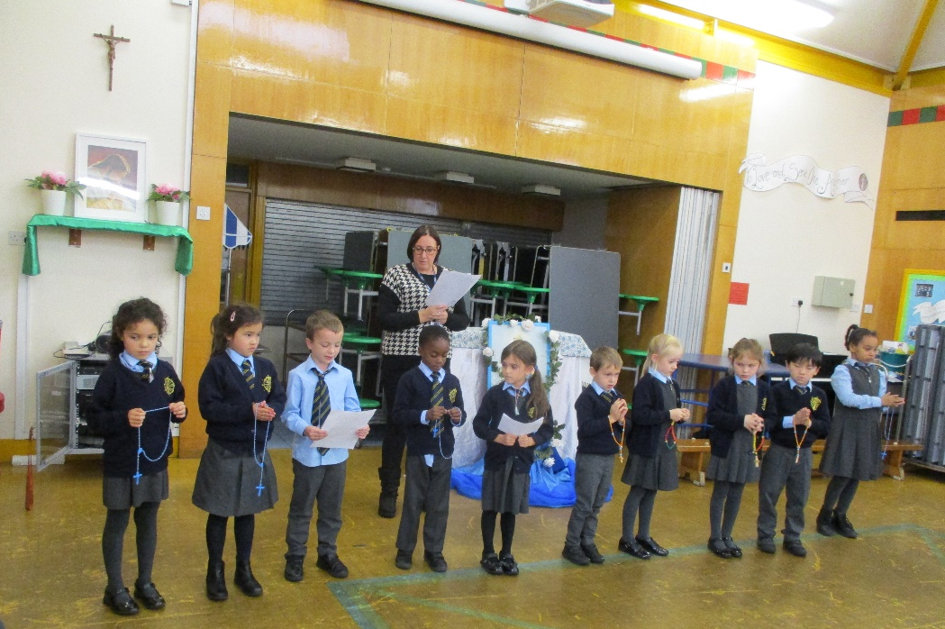
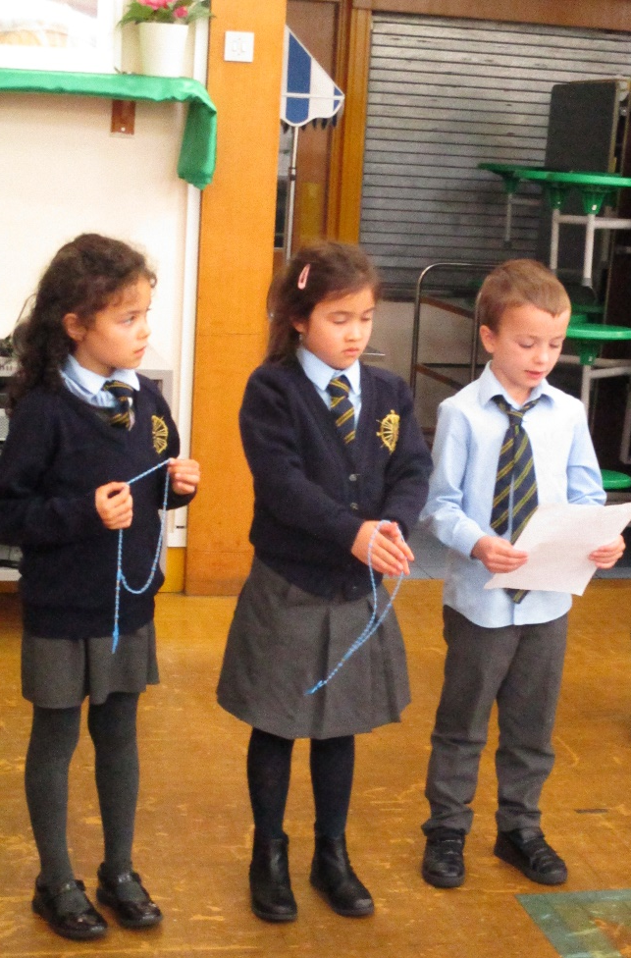
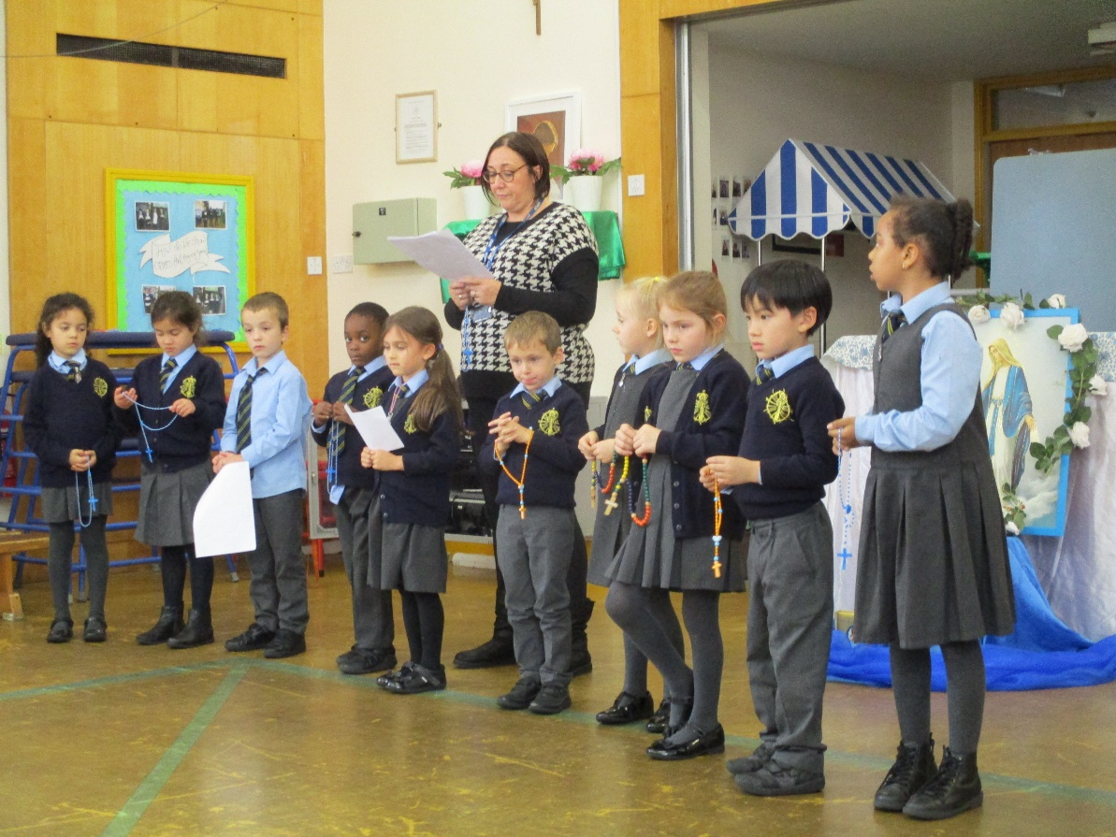
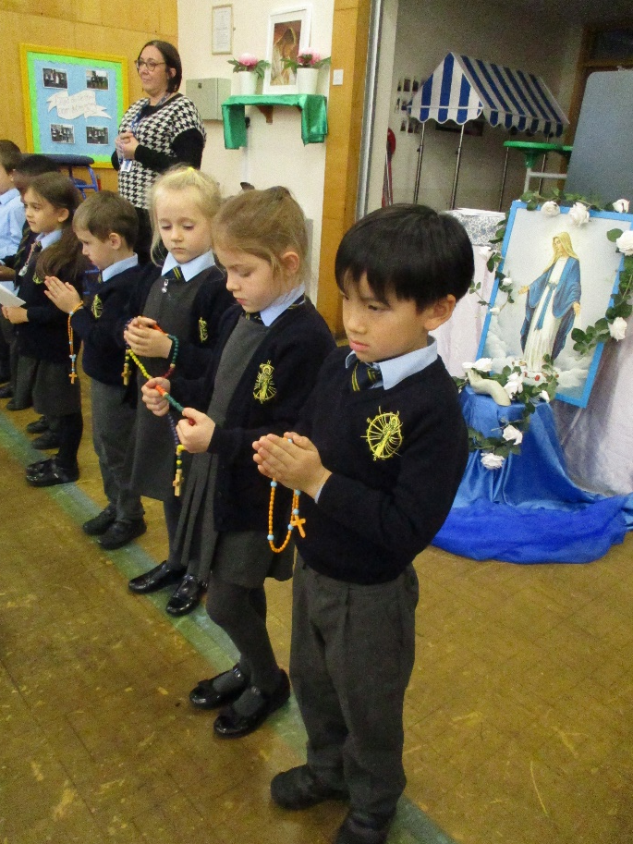
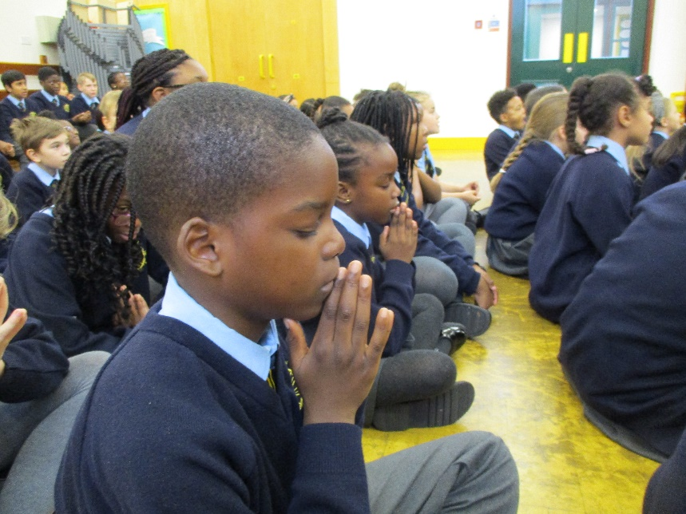

Slide 7
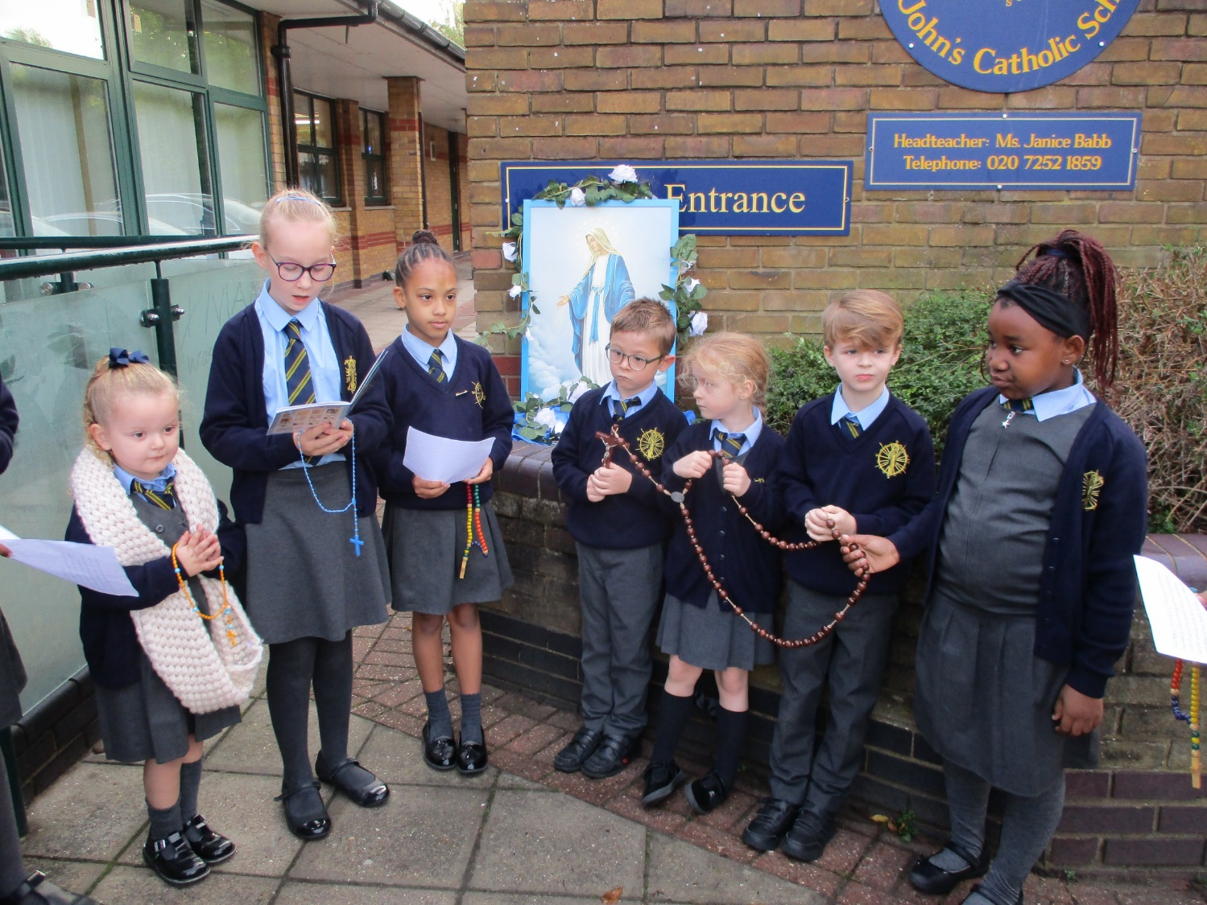
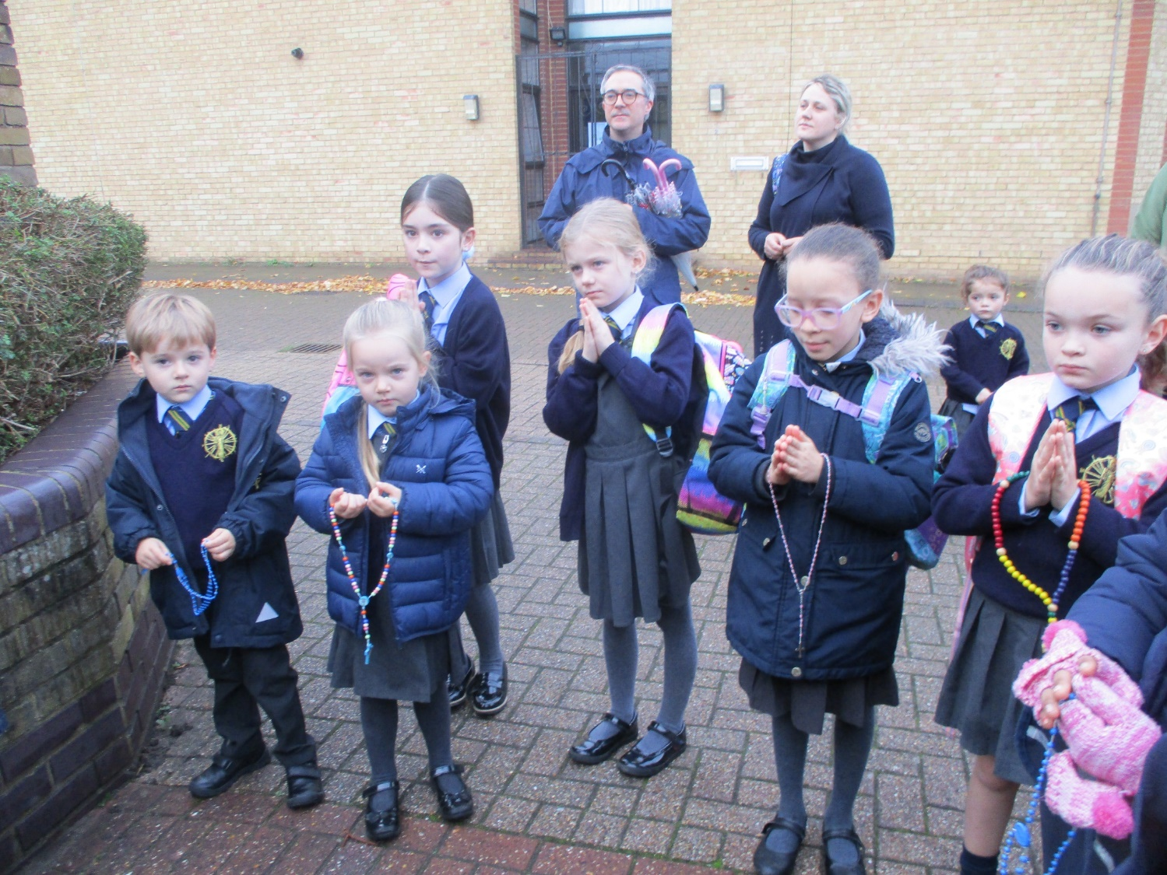
To celebrate the Rosary Week parents joined with our pupils before school to by praying a decade of the rosary each morning

Slide 8
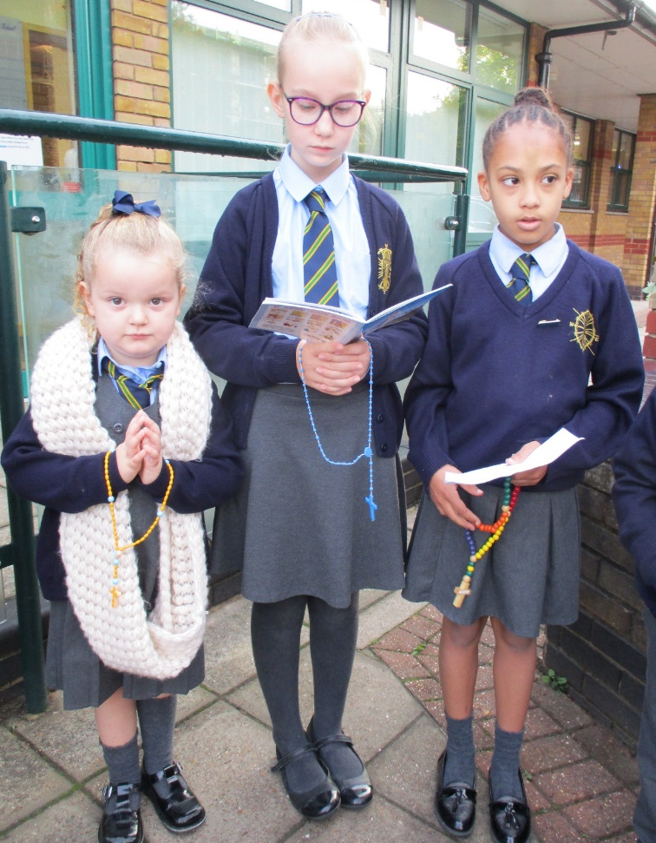
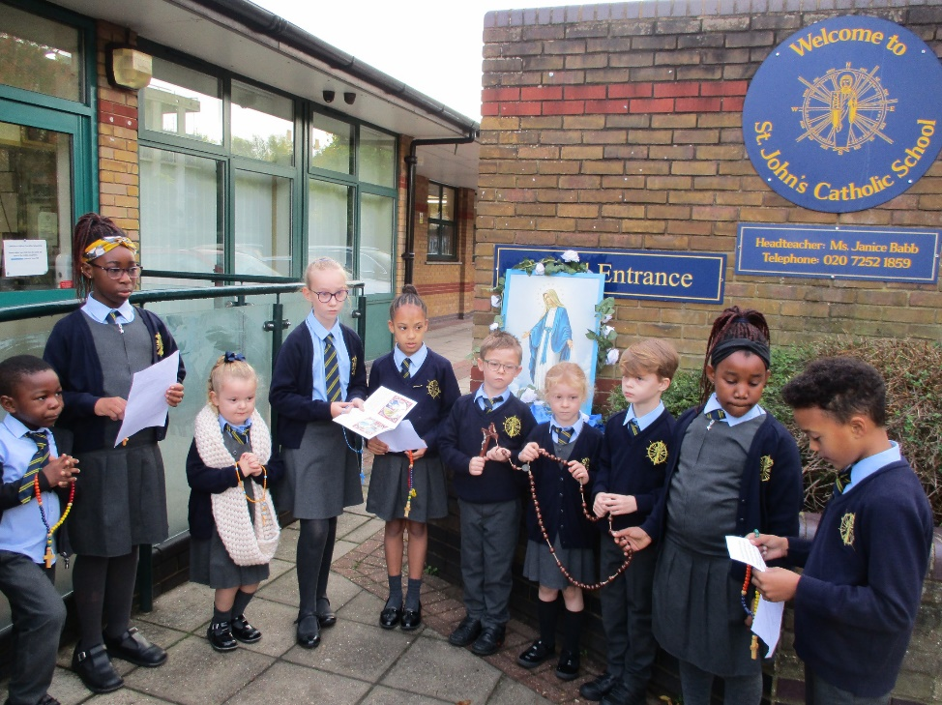
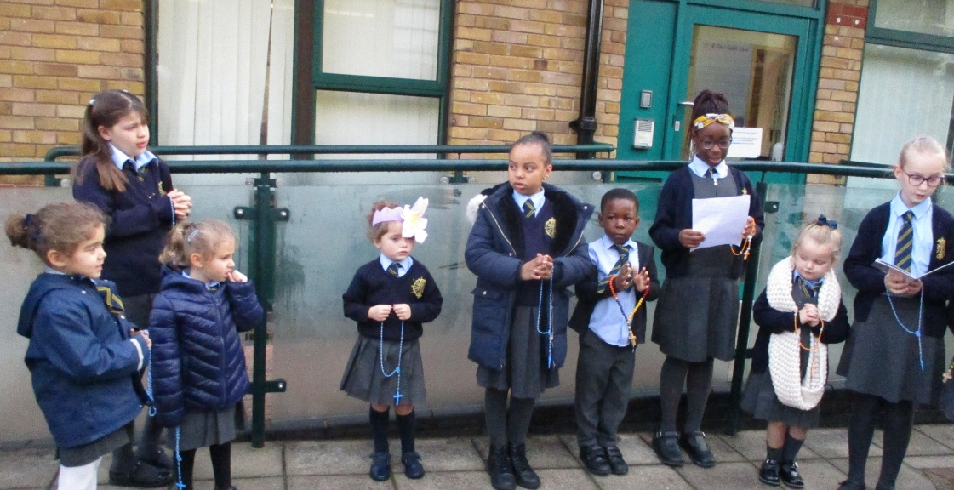

Slide 9
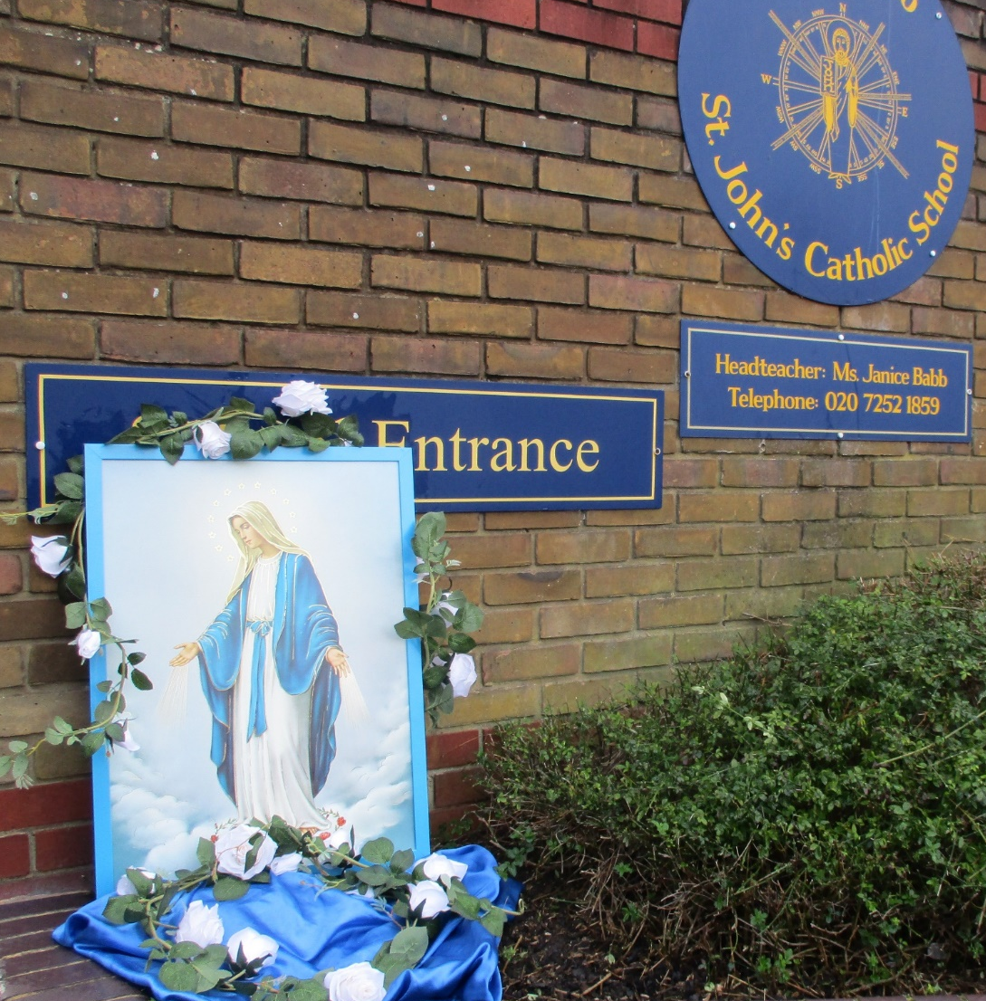

Slide 10
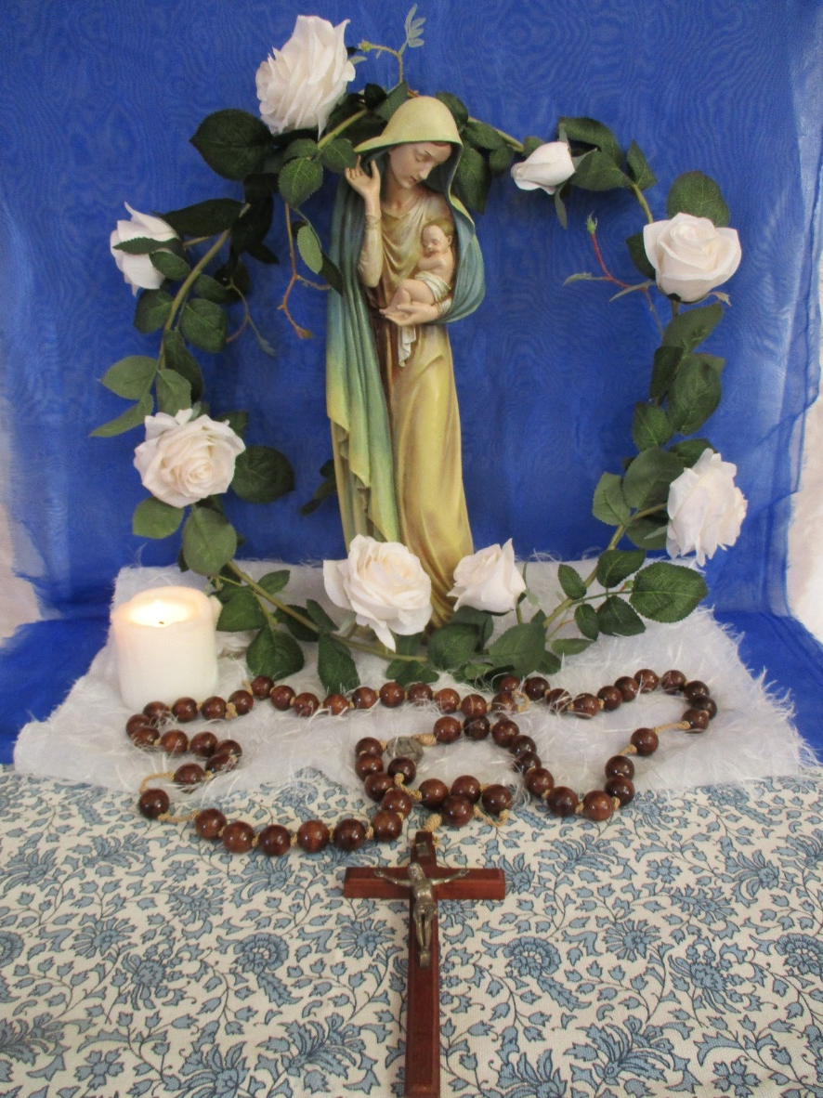
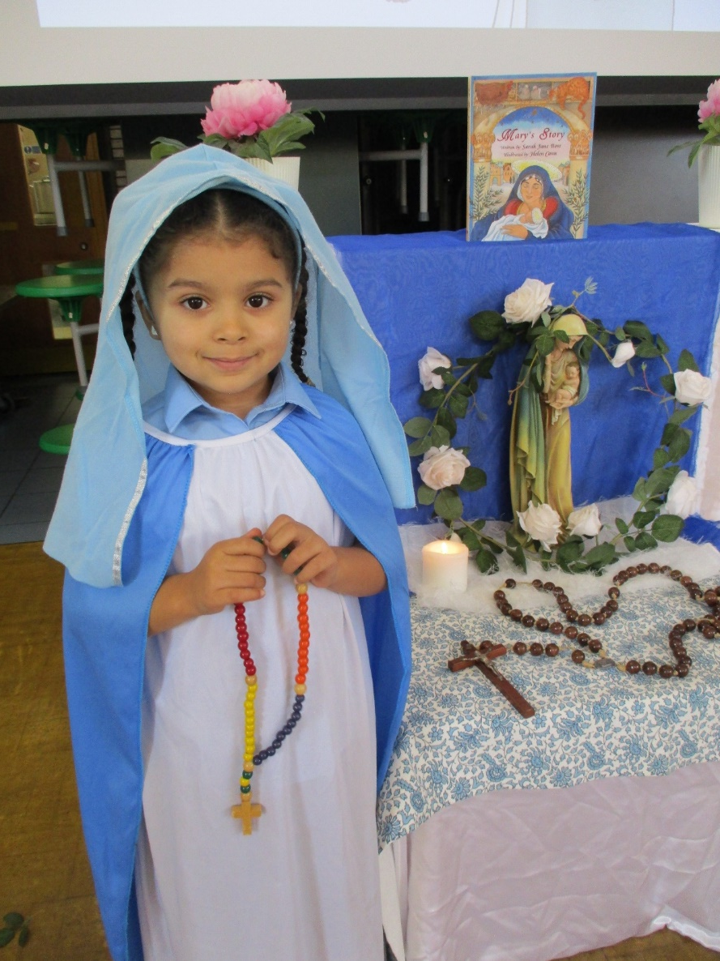
The Feast of Our Lady of the Rosary 7th October
We had a special assembly in school to mark this occasion.

Slide 11
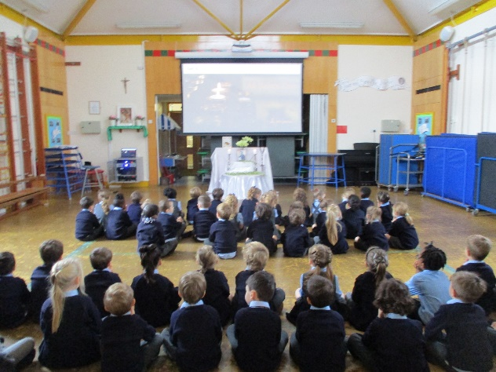
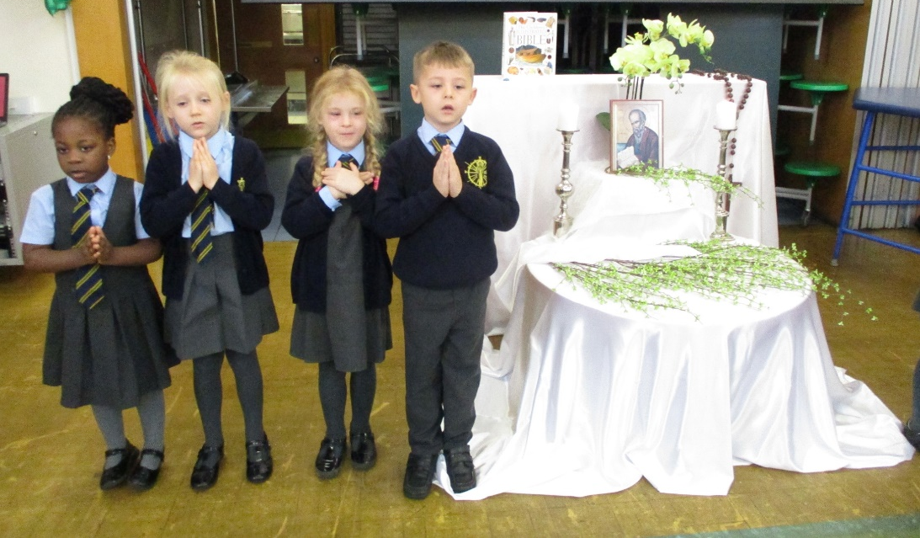
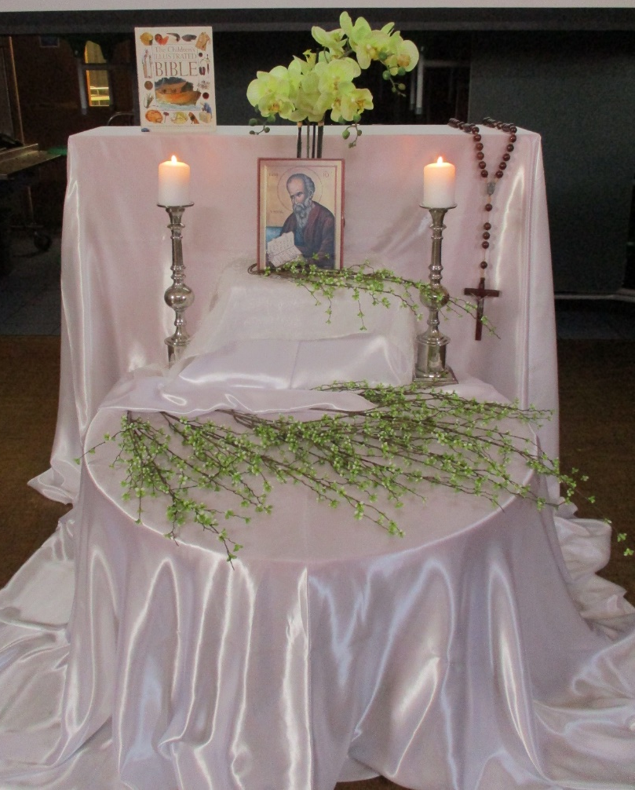
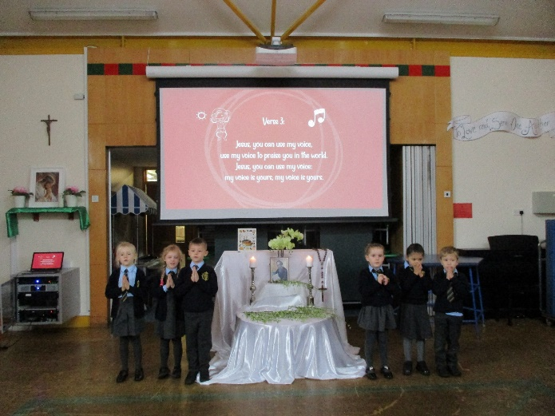
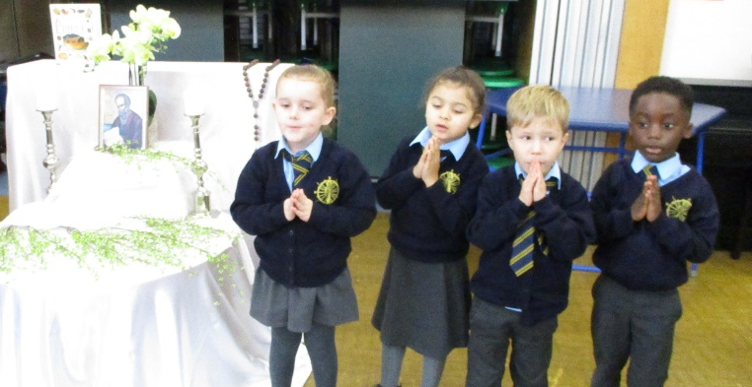
All Saints’ Day
On 1st November, we celebrated All Saint’s Day. It is a time when we remember all of the saints who have died and the wonderful things they have done. KS2 children attended mass, KS1 children had a special assembly. In the assembly the children prayed and gave thanks to the saints. They learnt that the saints in heaven can strengthen and help us to follow the path that leads us to God’s love and the lasting happiness he offers to all. We are all called by God to be saints and to let his love shine out through our lives to fill the world with the light of his love! The Gospel, children heard today, helps to shape our lives and make them pleasing to God. If we can grow closer to God we will find the true and lasting happiness that the saints already enjoy

Slide 12
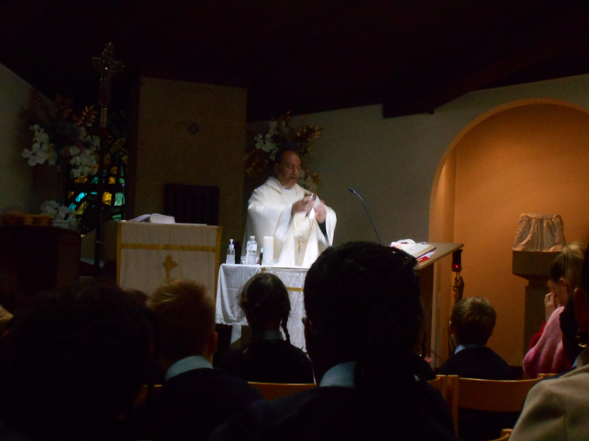
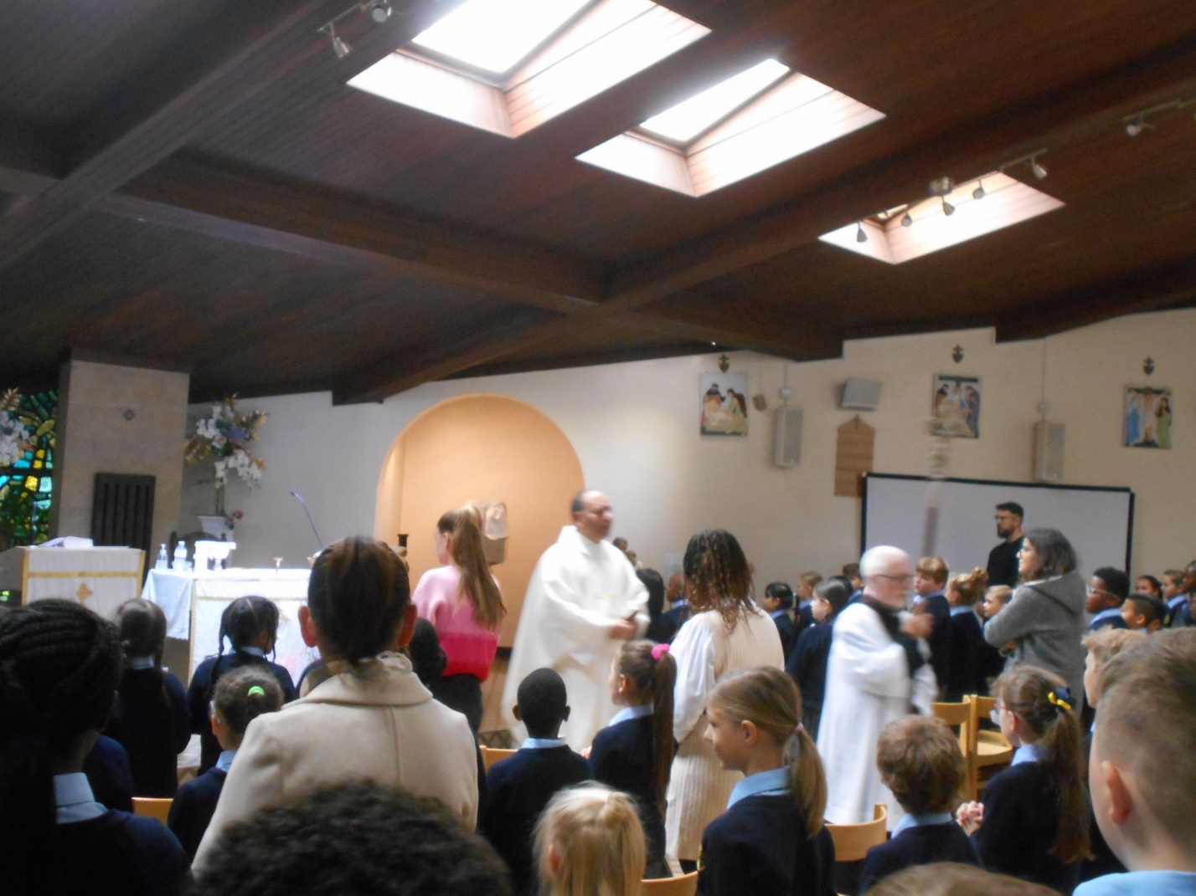

Slide 13
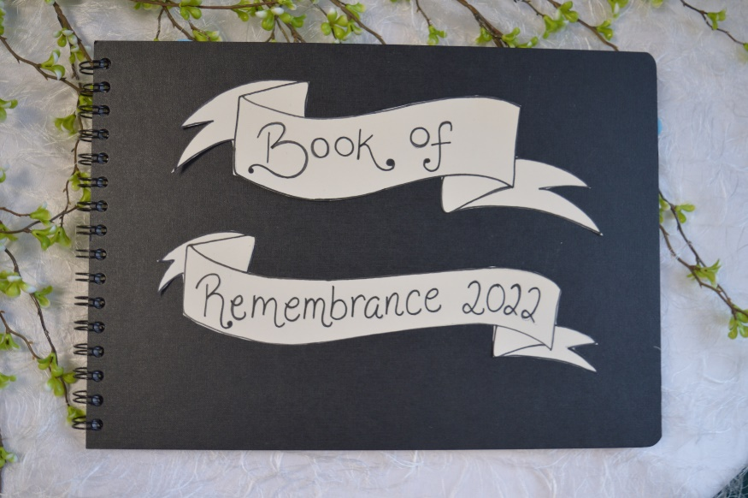
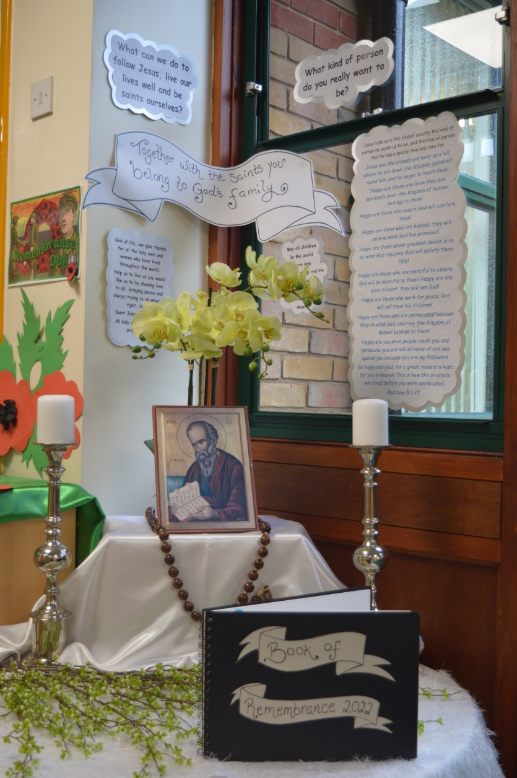
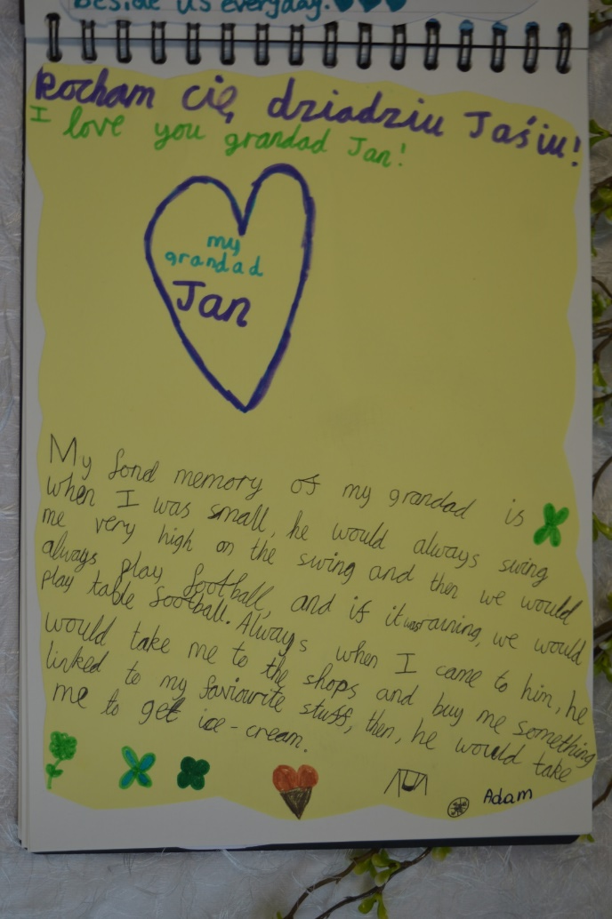
Book of Remembrance
Homework
The month of November is traditionally a time in which we remember those who have died.
Think about all the people you know who have died. Write their names and bring them back to school. We will collect them and put them into our book of remembrance. We will display the book in our school during the month of November.
You could also write a prayer for your loved ones. Or you could write a fond memory, or something you loved about their character, you can even share a funny story that you remember about them.

Slide 14
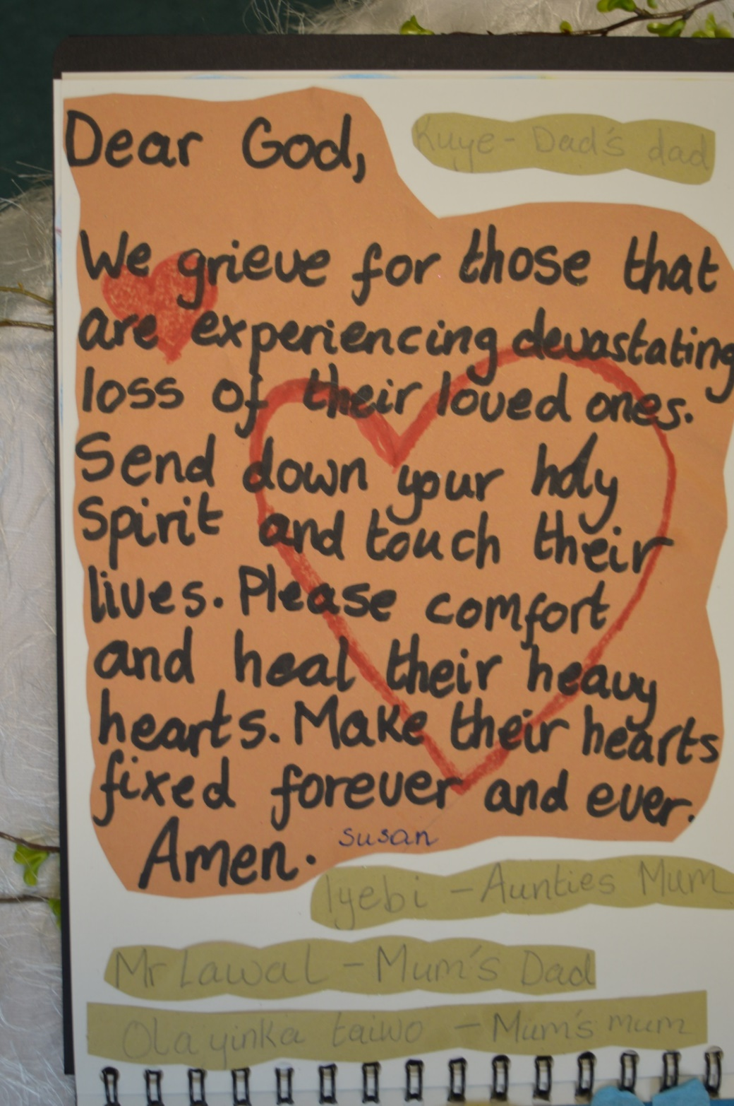

Slide 15
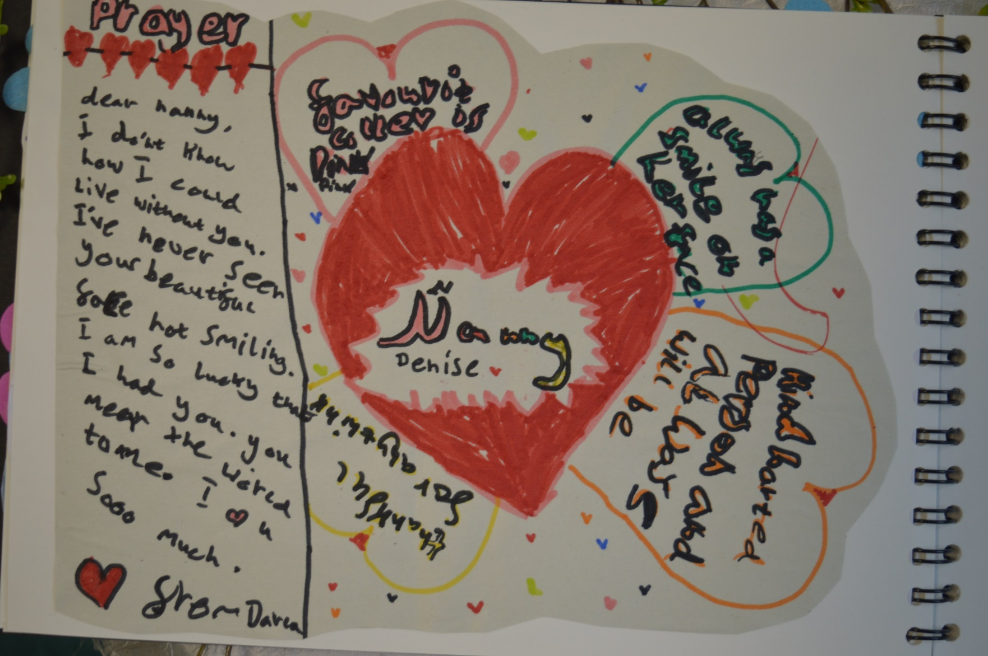

Slide 16
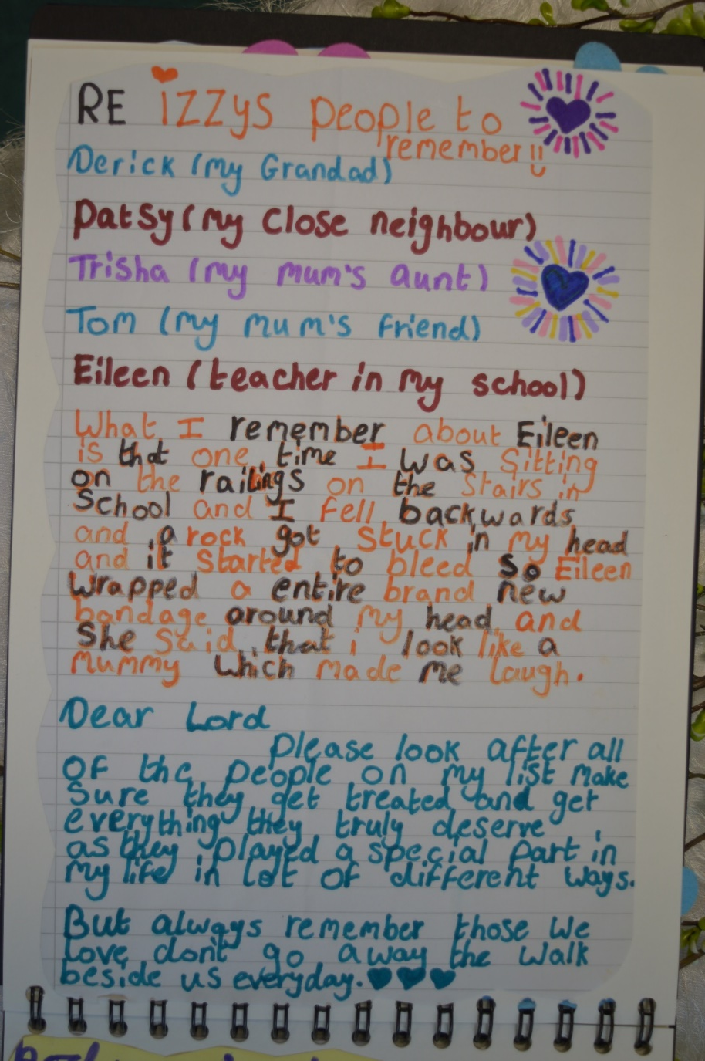
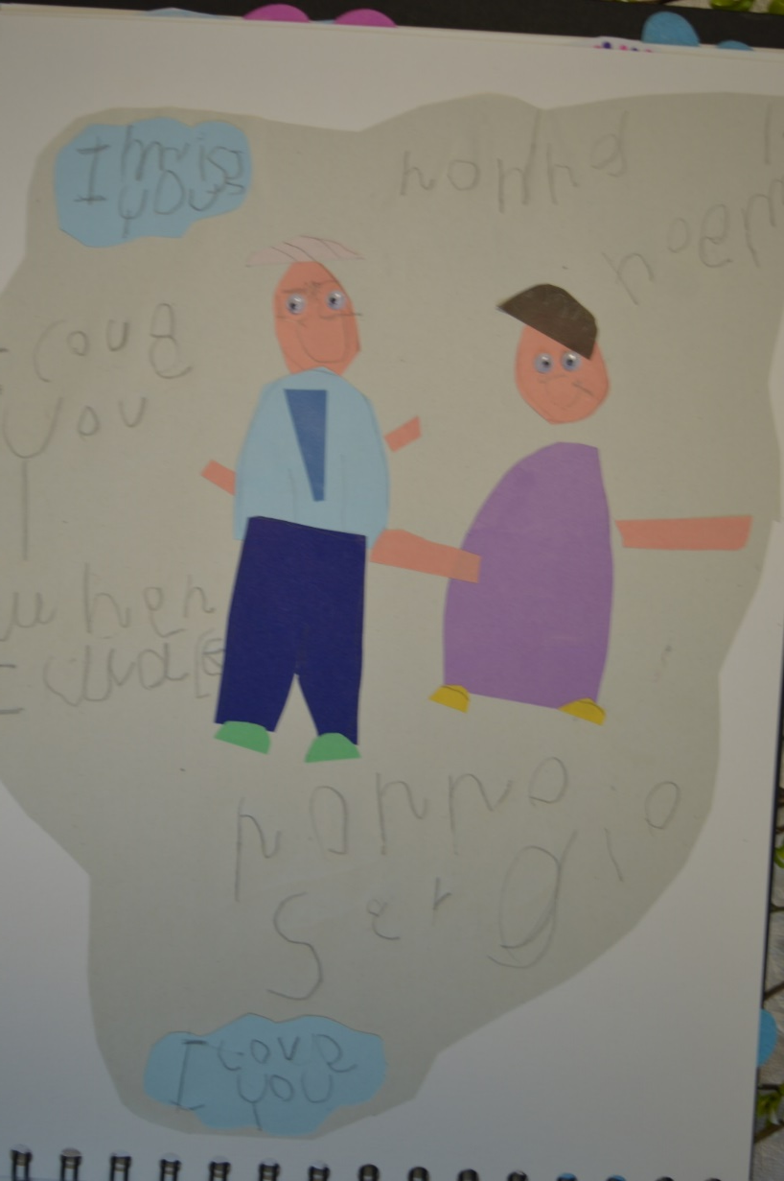

Slide 17
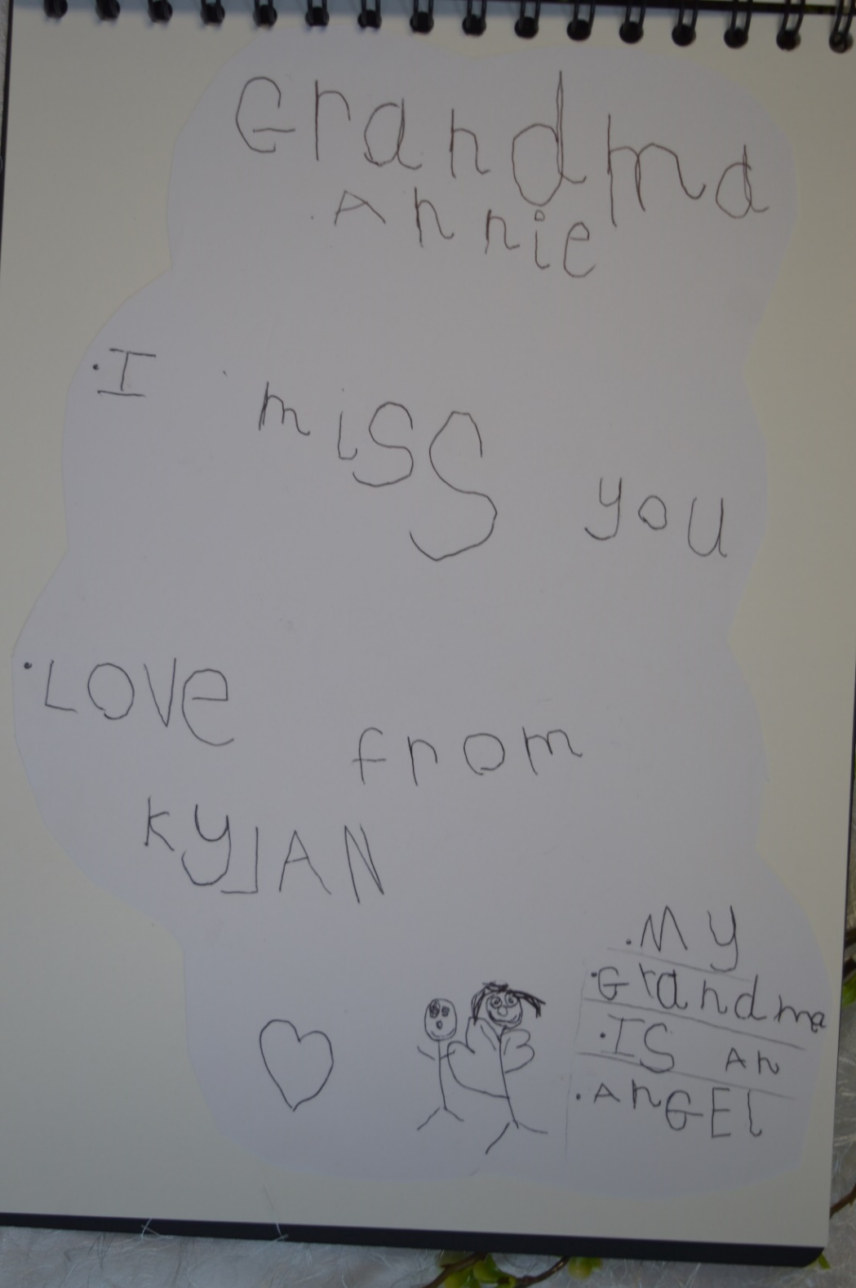
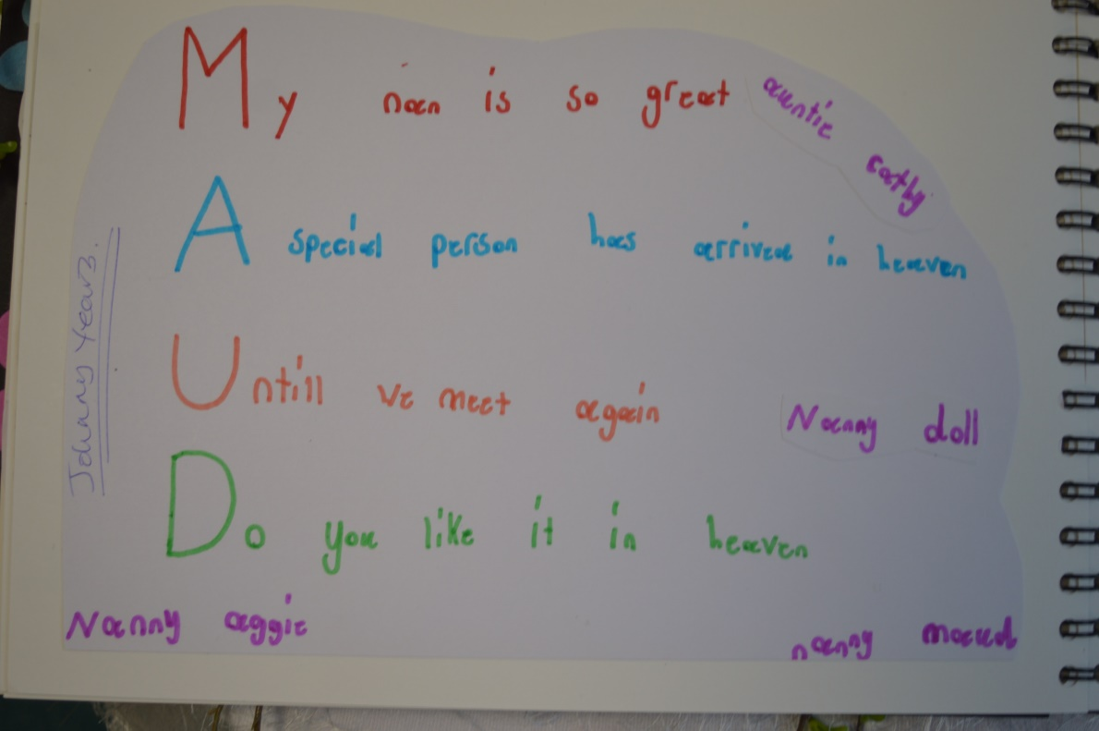

Slide 18
Reception and Year 1 children visited our church.

Slide 19
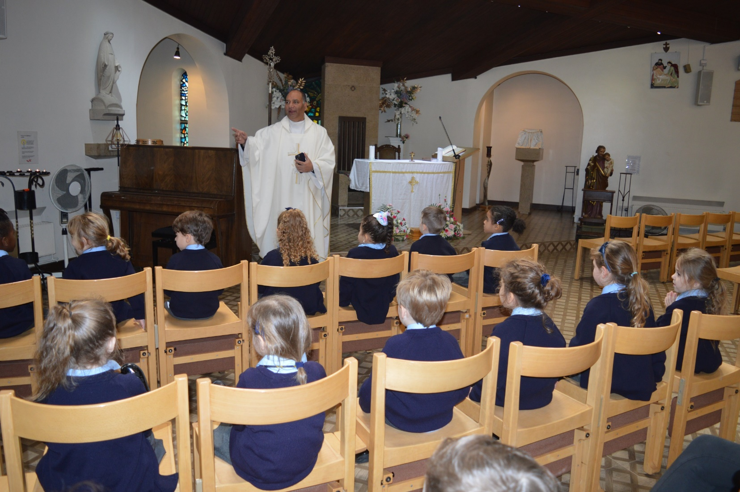

Slide 22
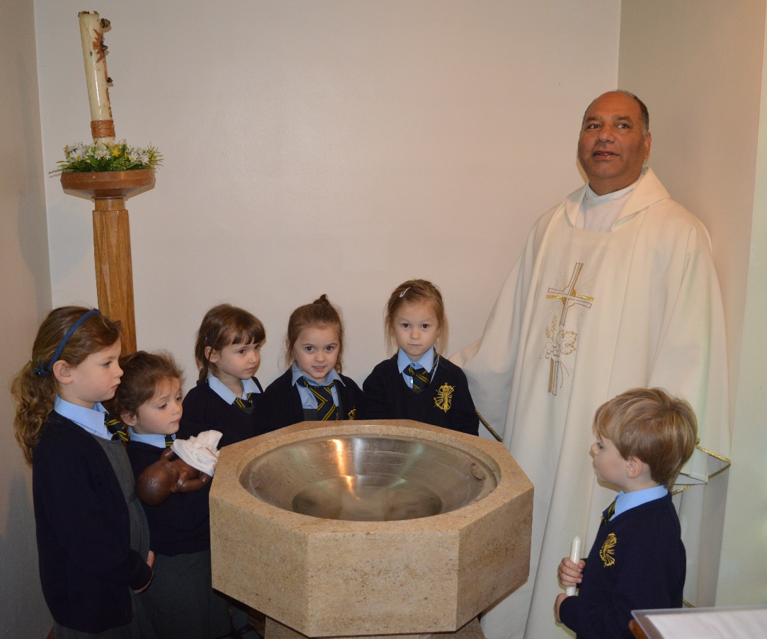
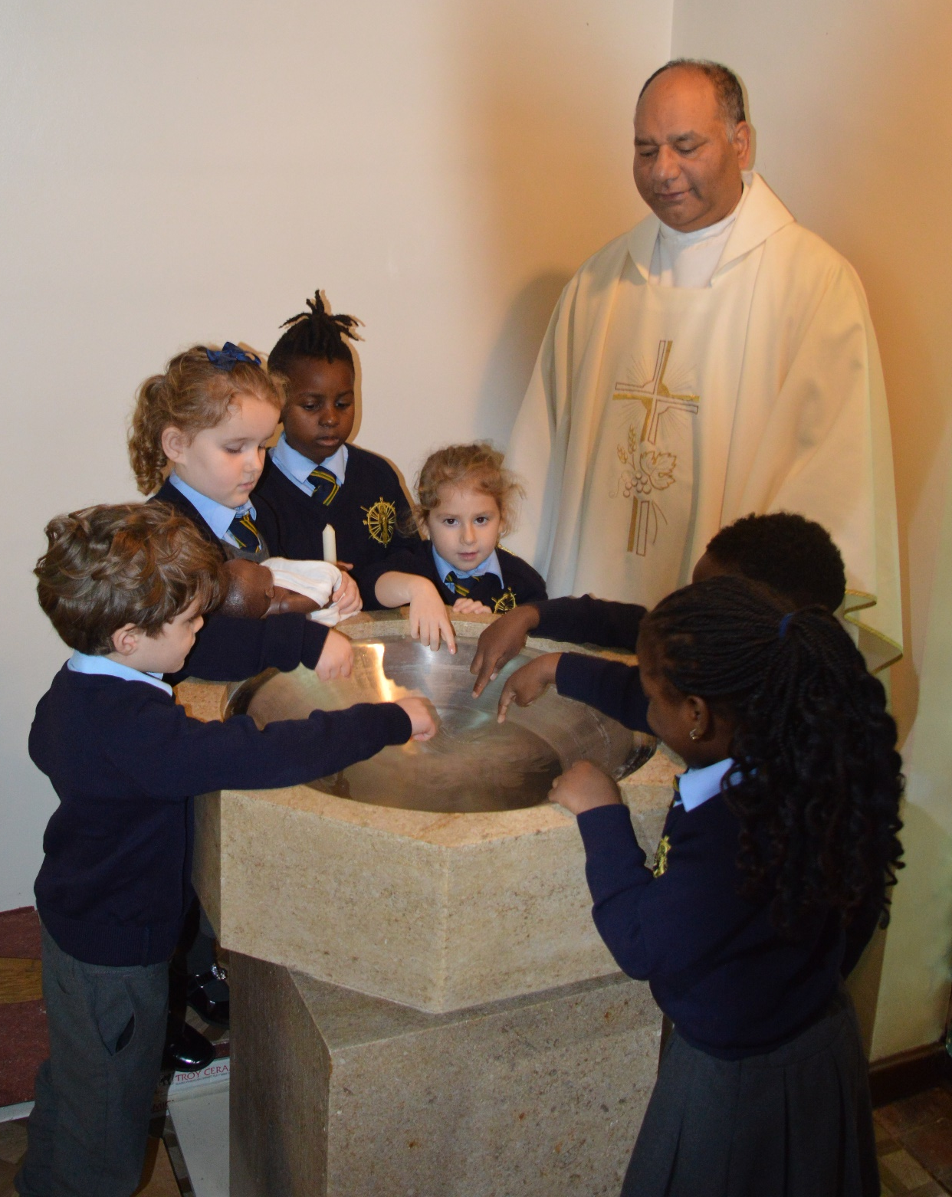
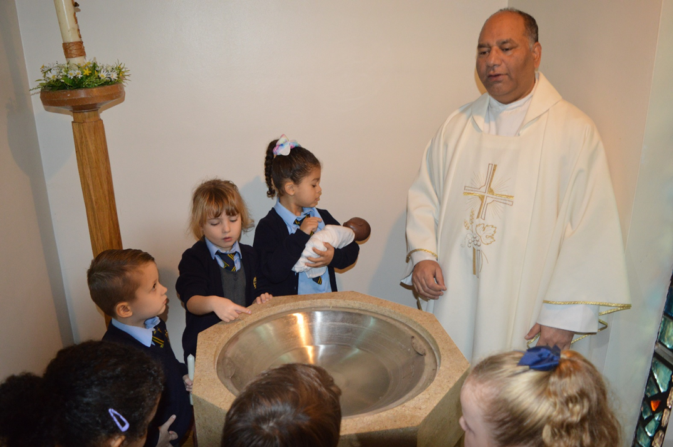

Slide 23
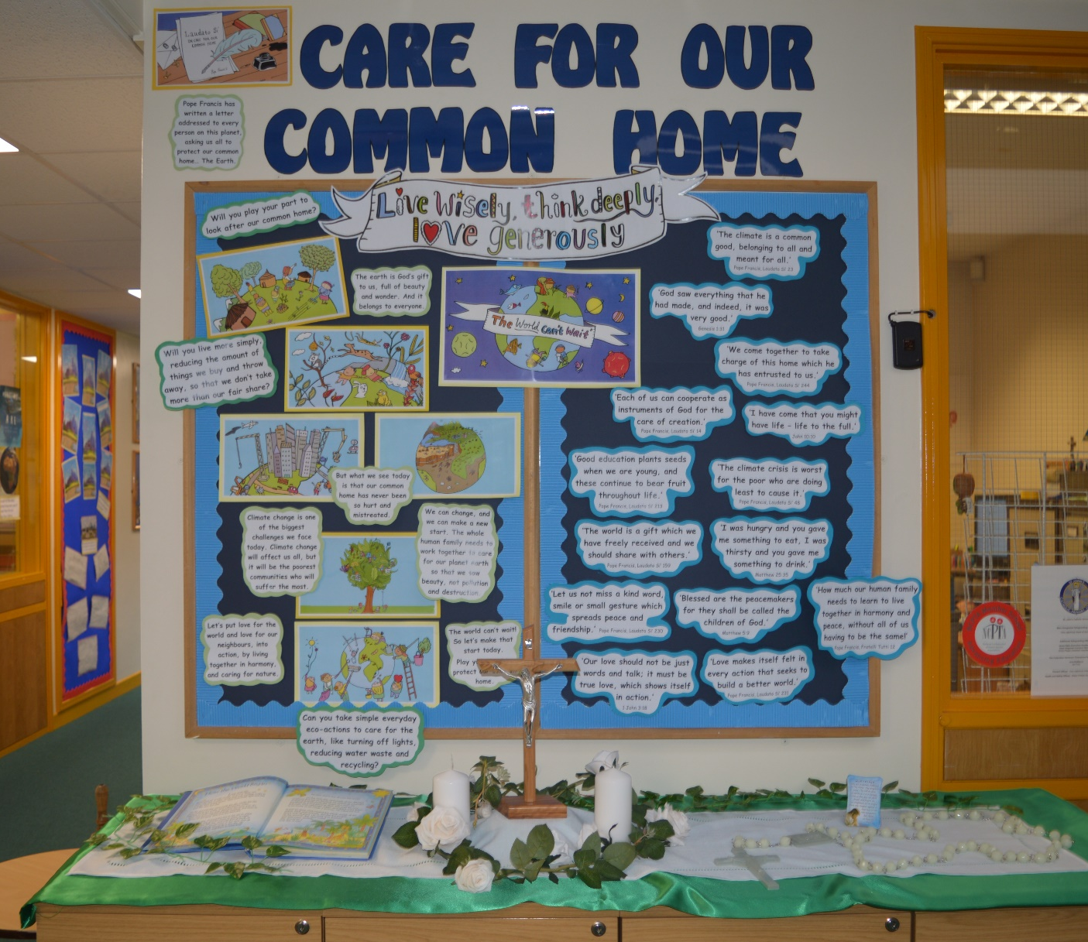
‘Laudato Si’ We want to look after our precious, wonderful world.
After special assemblies about Laudato Si, each class made a poster illustrating Pope Francis' important message to all of us; Care for Our Common Home.

Slide 24
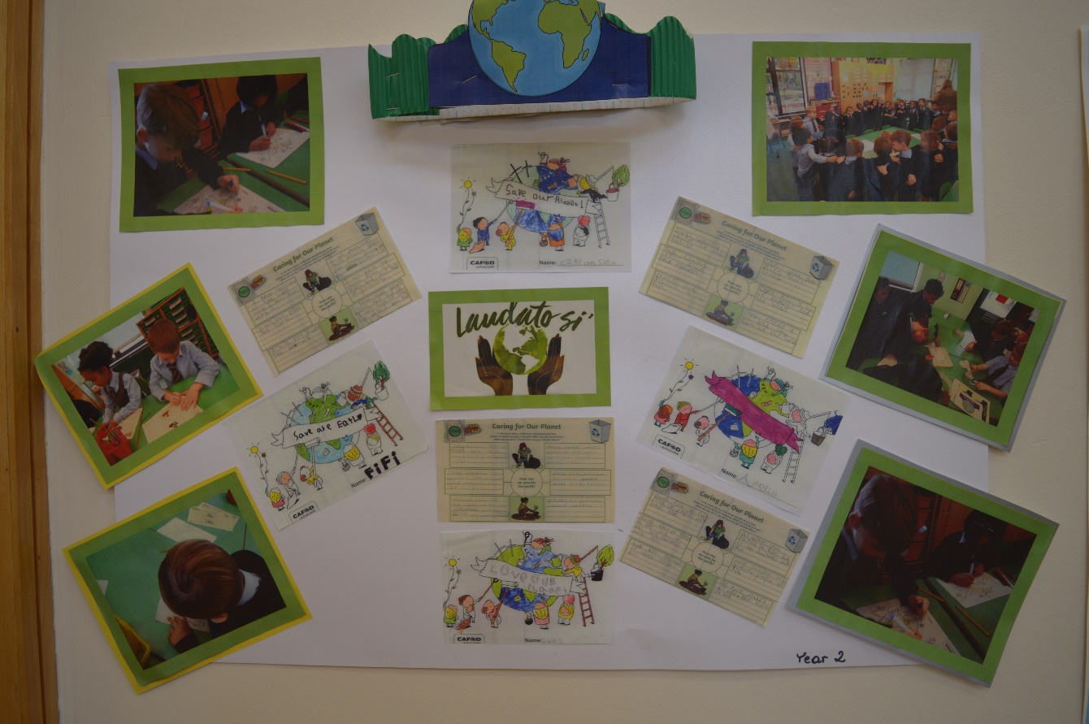

Slide 25
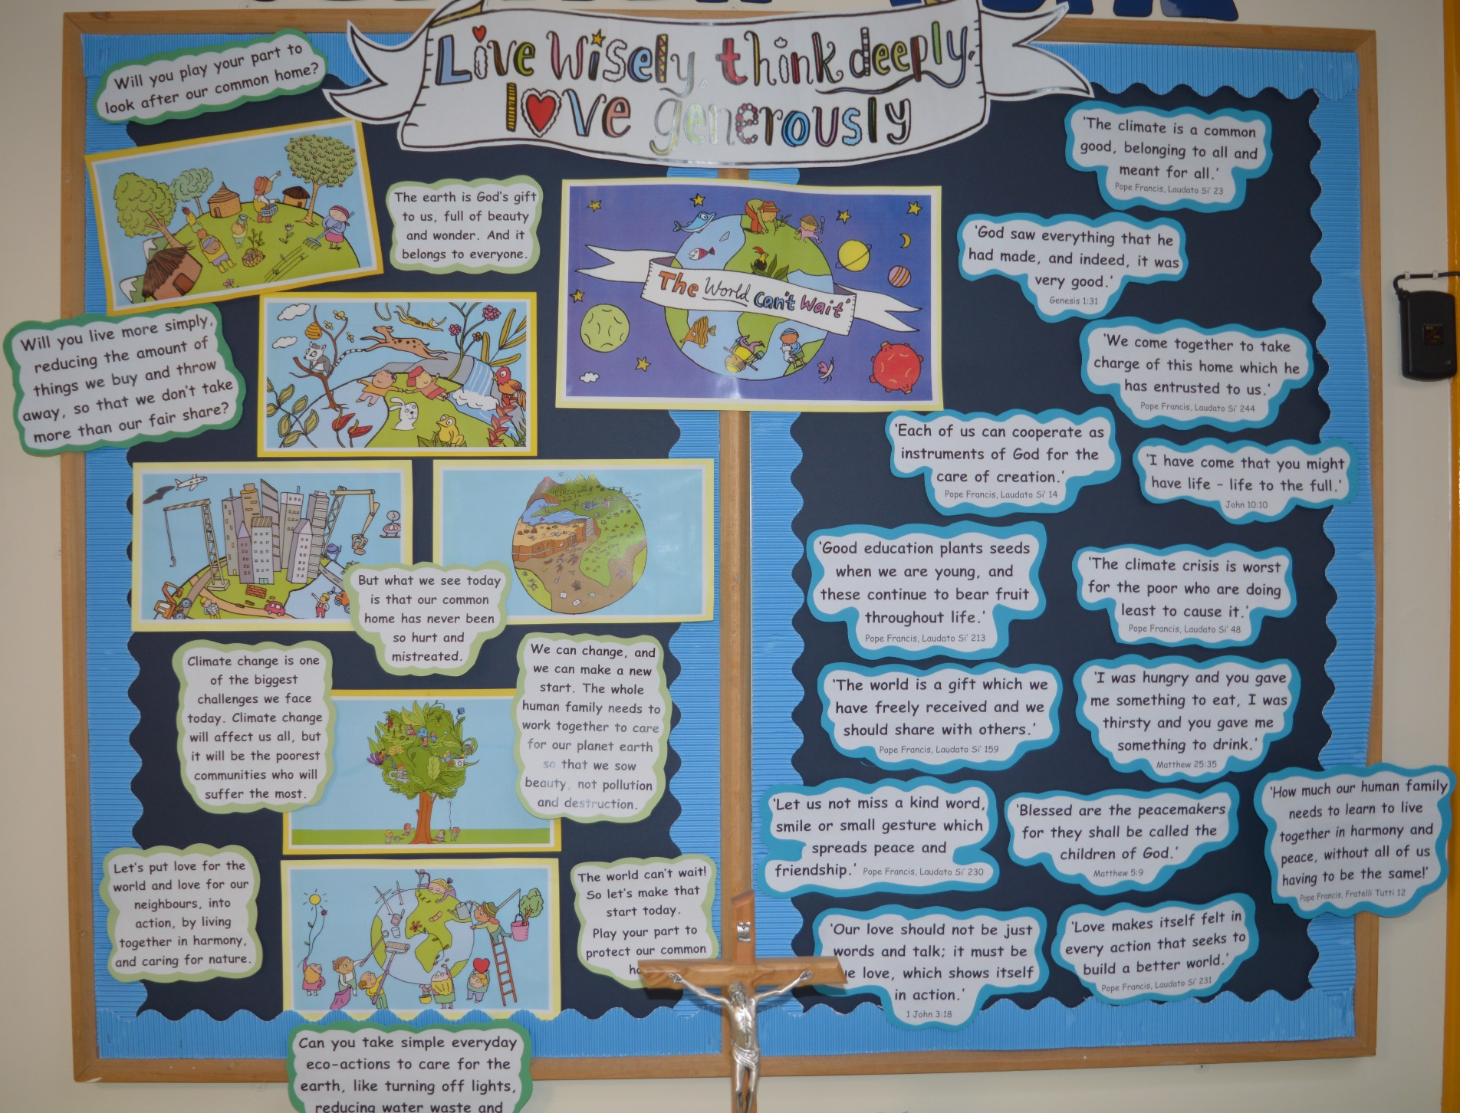

Slide 26
Poppy Appeal
During the month of November we are selling poppies on behalf of the Royal British Legion.

Slide 28
Remembrance Day

Slide 33
St John We had a special assembly for our Patron Saint St John. Each class wrote a prayer to St John.
“A new command I give
you: Love one another.
As I have loved you, so
you must love one
another.
John 13:34
Dear St John,
You were a good friend to
Jesus, help us to be good
friends to everybody.
You told us to love one
another, help us to
show love to others by
listening, being kind
and working hard.
St John Pray for us
Amen
By Year 2
Dear St John,
Thank you for being Jesus’ friend,
Thank you for looking after Mary,
Thank you for telling us about Jesus in your stories.
Please bless us every day when we go to school.
Help us to be proud of our school jumpers with St
John’s logo, as we wear them every day.
Help us to love and serve one another in everything
we do. We are your children, the children of St
John.
Amen
By Reception Class
Dear St John,
Thank you for blessing our school in your name.
Thank you for being the patron saint of our school.
We pray to you so we can get the wisdom, courage
and understanding to get closer to our Lord Jesus
Christ. Help us to be more like you and to be
thankful that Jesus died on the cross so our sins
could be forgiven. Please protect us from any evil.
Amen

Slide 34
Children in Need
We raised £150 which will go
towards helping children all over
the UK thrive and be the best that
they can be!

Slide 35
Advent 2022

Slide 36
Mary and Joseph visiting our home During Advent as part of our preparations for Christmas, everyday one child from Reception Class and KS1 has been taking home Mary and Joseph as we await the birth of Jesus.

Slide 37
St John’s Christmas Tree

Slide 38
Advent Homework

Slide 40
KPMG CAROLS
Our school choir were invited to take part in the KMPG Festive Carol Service. They performed wonderfully and enjoyed every moment!

Slide 41
The Christmas Story by Reception Class

Slide 45
Corridor Displays Advent 2022 The Christmas Story
Year 6
The Angel Gabriel visiting Mary to tell her she is going to have a baby.
Year 5
Mary and Joseph travelling to Bethlehem to register in a census.
Year 4
Mary and Joseph arriving in Bethlehem. (An innkeeper in Bethlehem let Mary and Joseph stay in his stable for the night.)
Year 3
Baby Jesus is born in the stable.
Year 2
An angel appearing to the shepherds. (The angel told them that the son of God had been born in Bethlehem.)
Year 1
The shepherds visiting Baby Jesus.
Reception
The Wise Men travelling to Bethlehem. (Far away in the East, wise men saw a bright star in the sky. They knew it meant that a new king had been born and followed the star.)
Nursery
The Wise Men reached Bethlehem. They gave Jesus gifts of gold, frankincense and myrrh.

Slide 54
Food Bank Advent 2022
Christmas is a time to share bright hopes, care for others and remember that everybody matters.
The children reflected that there is a Christmas spirit that can change the lives of others. The children remembered others who need help at Christmastime. The children were thankful for charities that bring comfort and hope and reflected upon what it might mean to give as well as to receive.

Slide 57
Dear God,
At Christmastime, help us to think of others, not just ourselves.
Help us to find joy in giving, not just in the things that we receive.
Thank you for charities that work hard to bring hope and comfort.
Please help each of us to do our part in bringing hope and peace to the world.
Amen.

Slide 58
The Nativity
The money
raised through ticket
sales were donated to
the Catholic
Children’s Society.

Slide 62
Christmas Carols

