Slide 1
The Catholic Life of St John’s School 2020/2021

Slide 2
Despite the pandemic and during the lockdowns, we have encouraged families to take part in the important events at home by sharing assemblies, prayers, reflections and lessons weekly through our remote learning offer and our ‘Catholic Life of the school’ web page.

Slide 3
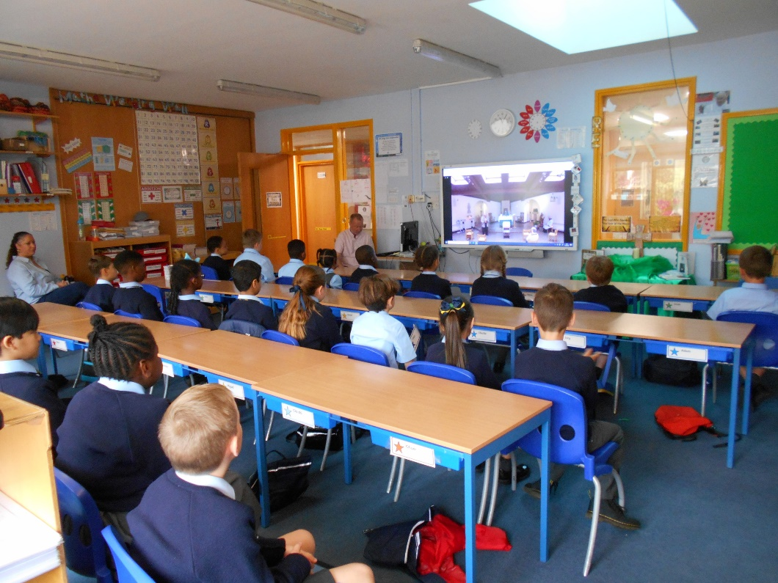
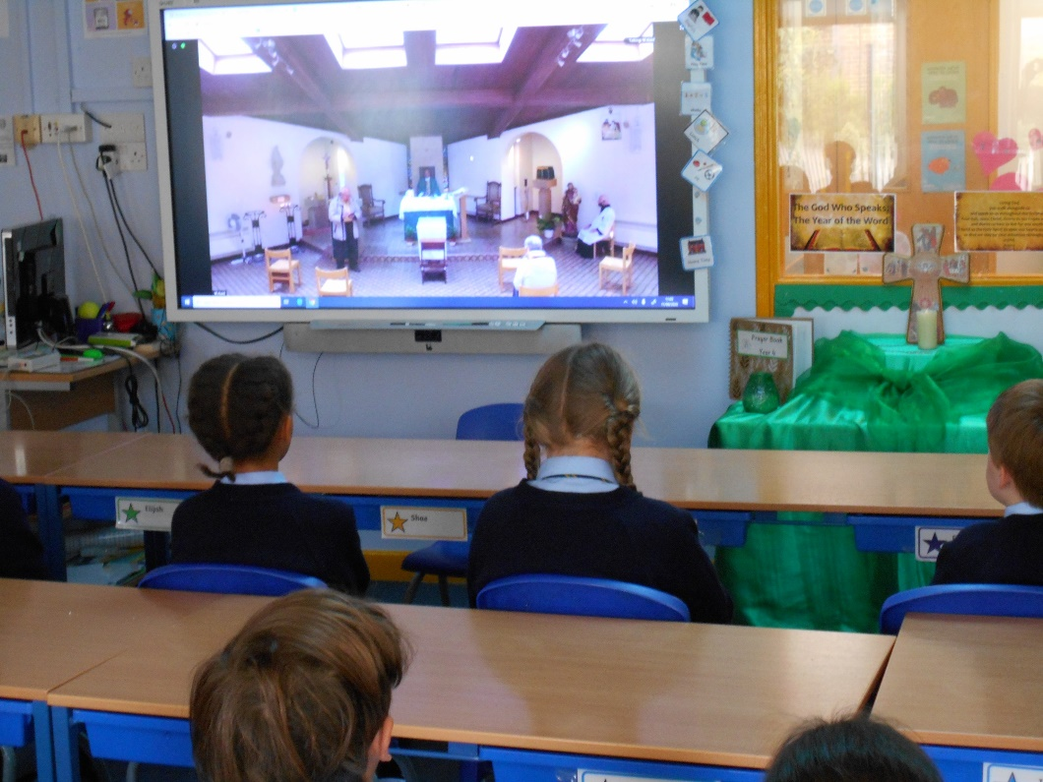
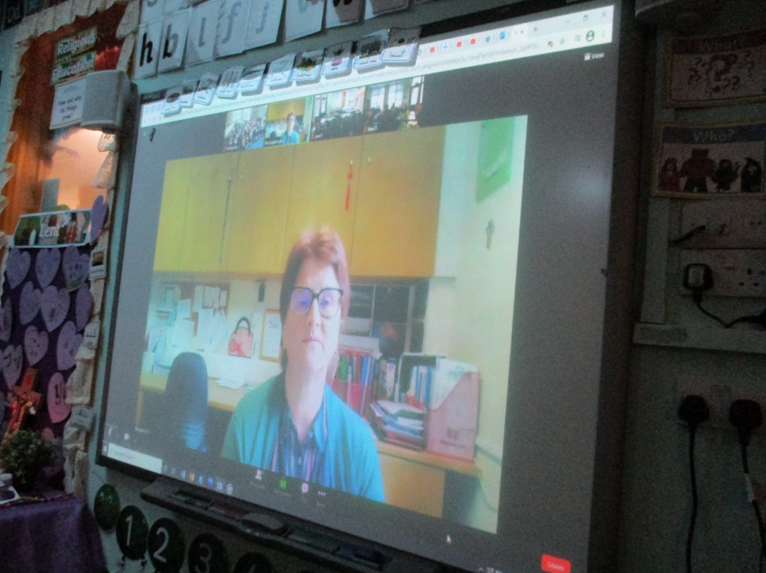
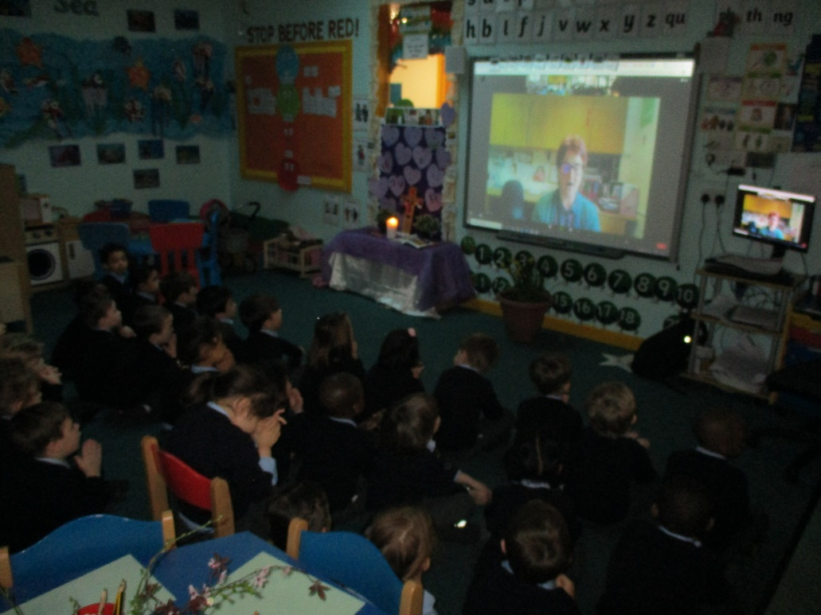
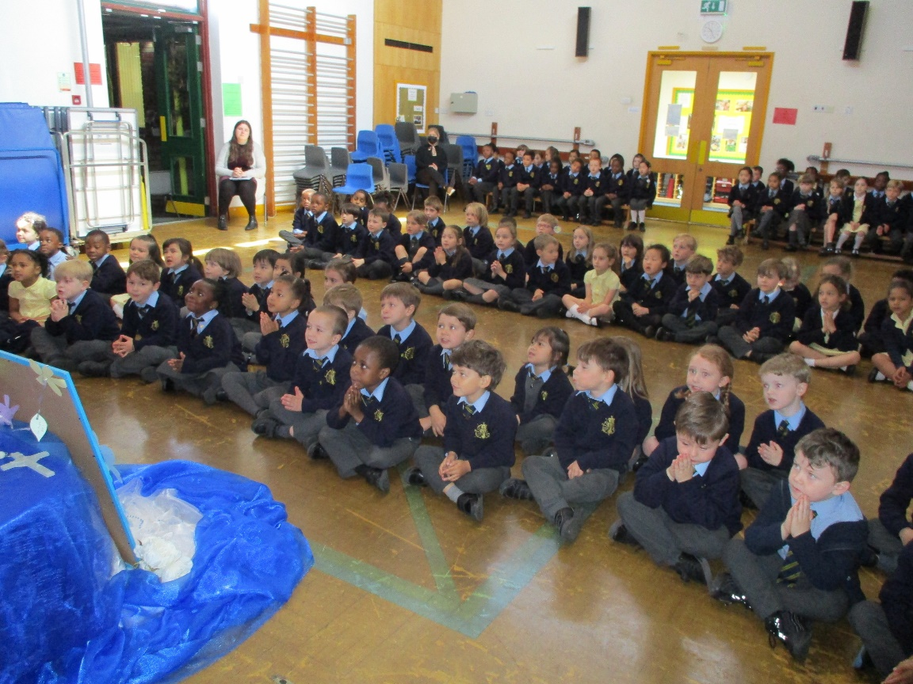
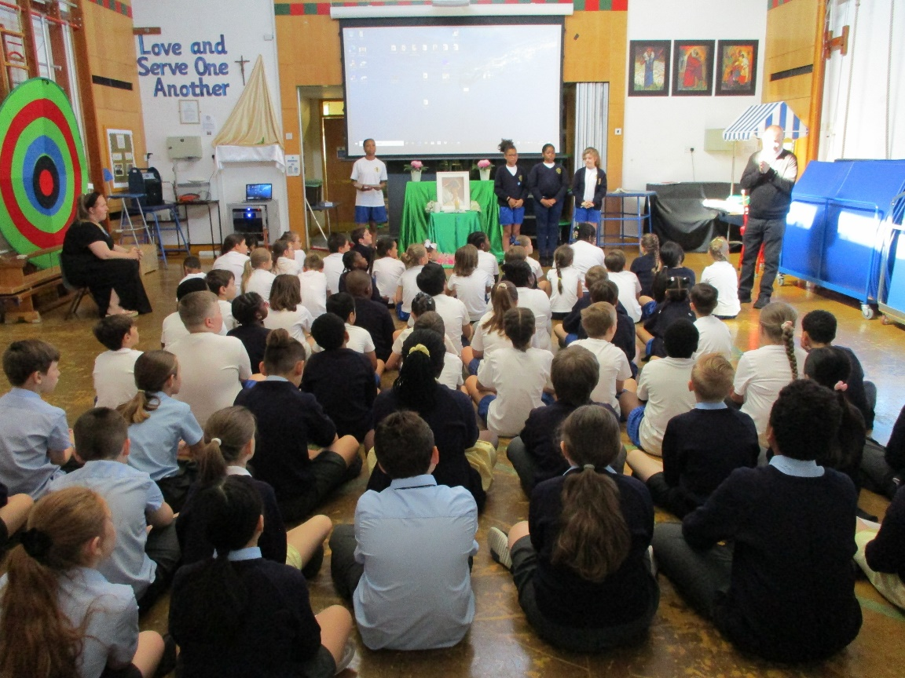
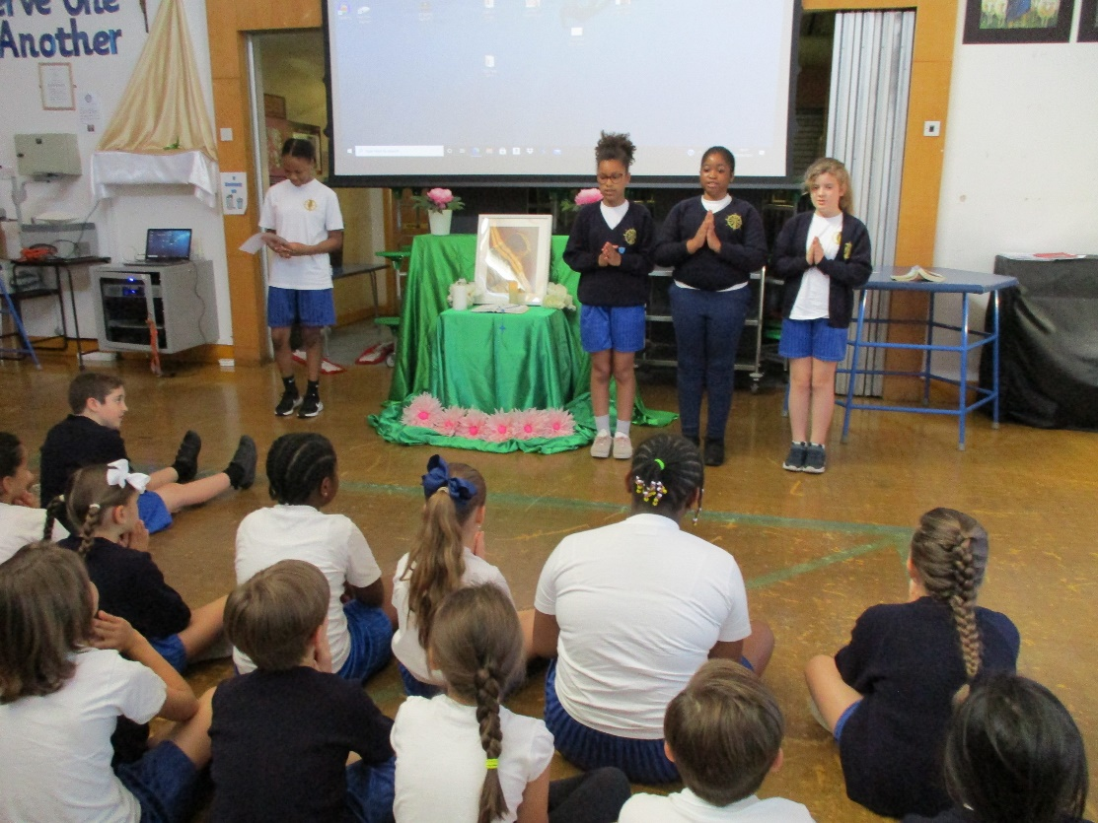
Masses and Assemblies Although restrictions have meant that children have needed to stay in class bubbles for most of the year, we have ensured that assemblies and acts of worship and reflection have been planned and delivered weekly in each class. Shared assemblies and Mass have been attended via Zoom so that we can still offer opportunities for the children and staff to take part in shared worship. These opportunities have been more important than ever to continue to foster the essential sense of community and belonging that has been impacted by the very many changes and restrictions that have limited contact between groups of children.

Slide 4
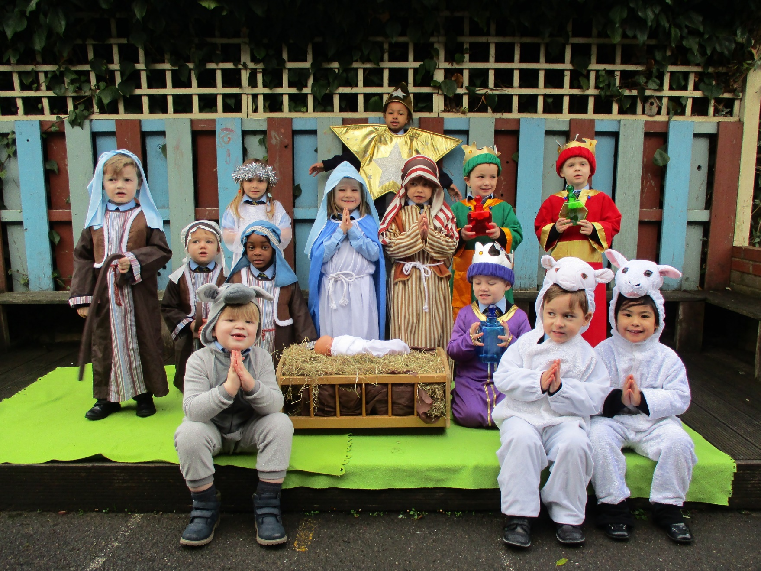
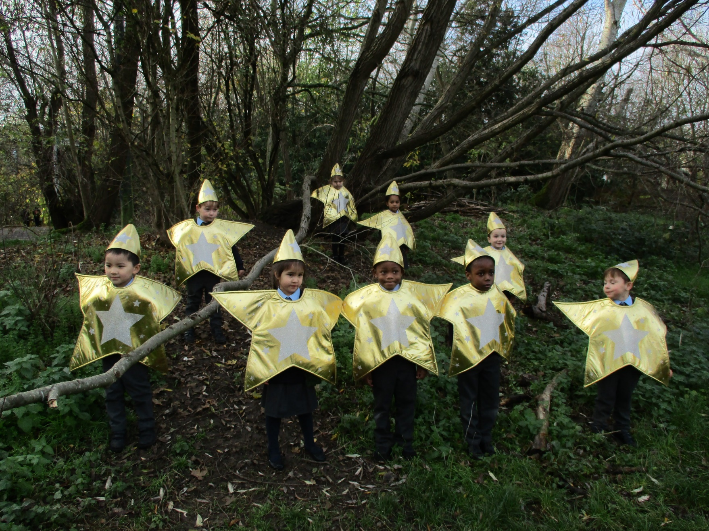
Nativity
The KS1 Nativity was performed in parts and recorded around the school and in the local woodlands. To ensure that the children could understand and reflect on the Christmas story the recording was incorporated within our class assemblies and was made available for children and families to enjoy and reflect upon together at home.

Slide 5
Rainbows of reflection To mark the first anniversary of the first coronavirus lockdown and responding to the bishop John’s invitation we took part in marking this occasion in prayer. Each class contributed to our whole St John’s Rainbow of Reflection by writing a prayer for each of the colours of the rainbow. Red hand prints- a prayer for family Orange person – A prayer for friends Yellow sunshine – A prayer for brighter days Green question mark – A prayer of thanks for what we have learned Blue teardrop – A prayer for someone we want to remember Purple heart – A prayer of thanks for heroes of the pandemic Pink stars – A prayer of thanksgiving for something we are proud of

Slide 6
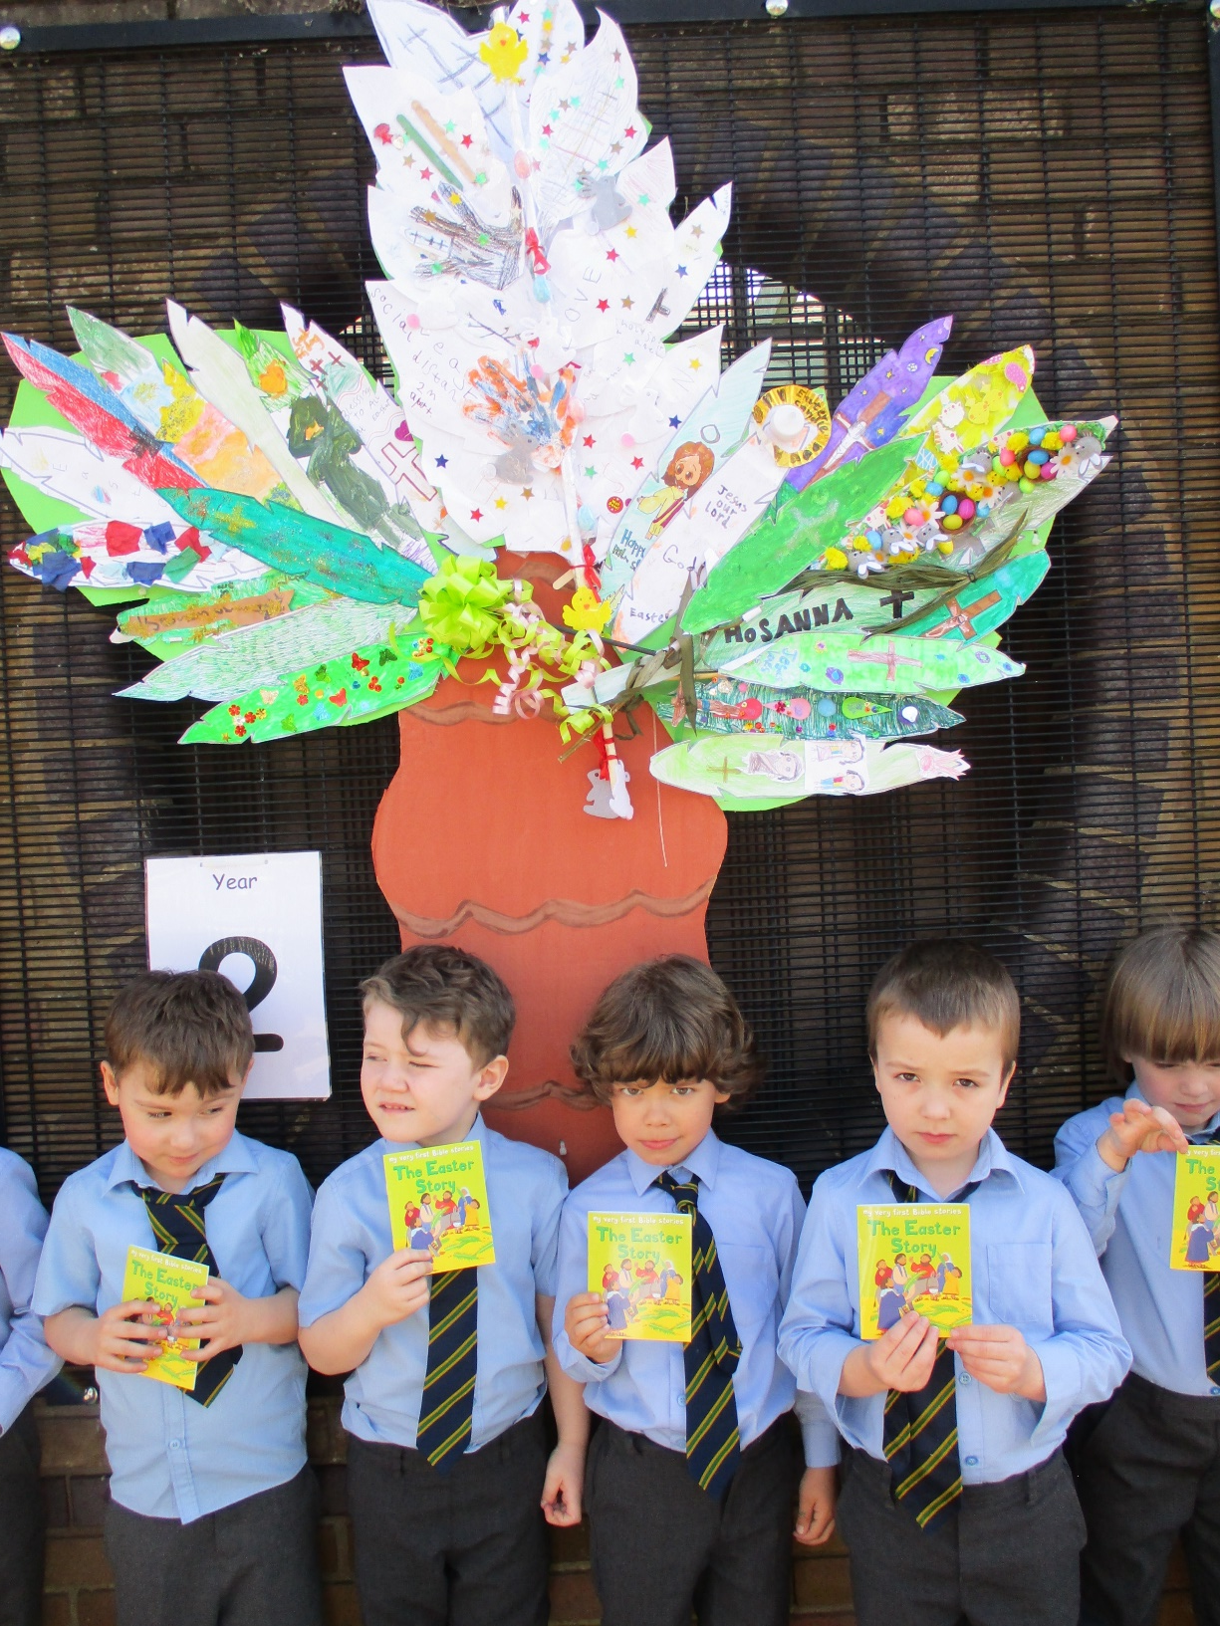
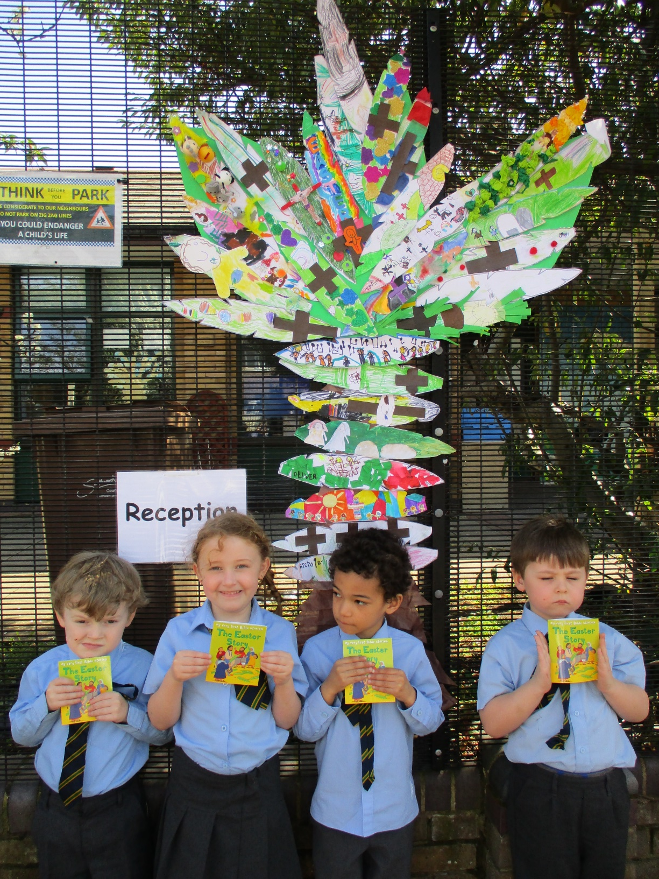
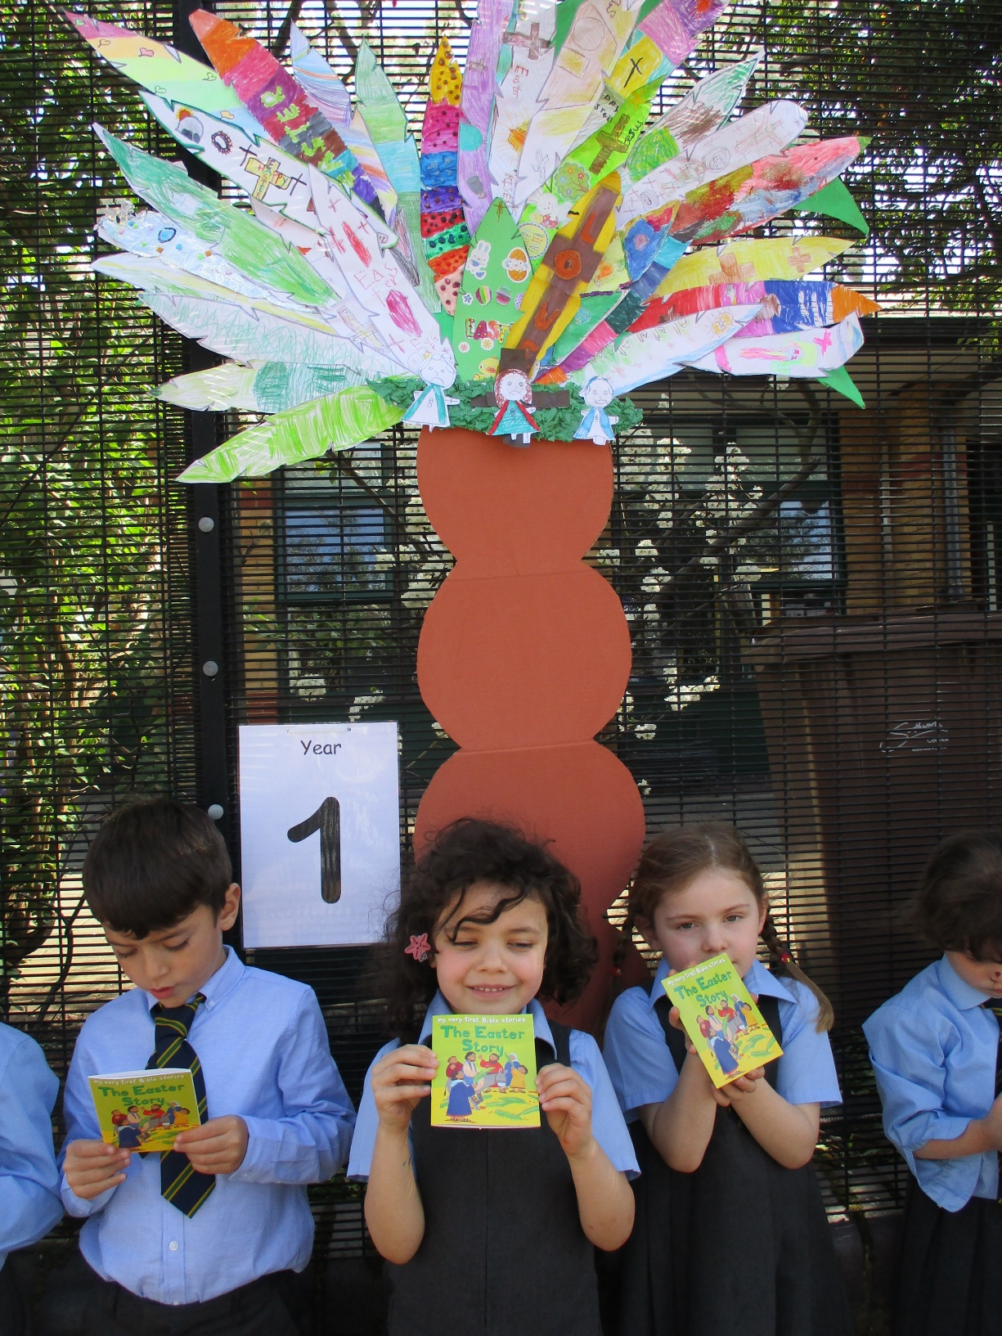
Palm Trees
As part of the Easter celebrations, children across the school designed a palm leaf based on the Easter story as part of a homework project. Each class used these palms to make a palm tree that was displayed along the outside of the school fence as witness to us being a Catholic community. Classes took turns to look at the trees and to reflect upon the Easter story. Families were also invited to come and spend time looking at the children’s work and prayers. Staff were overwhelmed at the feedback and comments from our parent community.

Slide 7
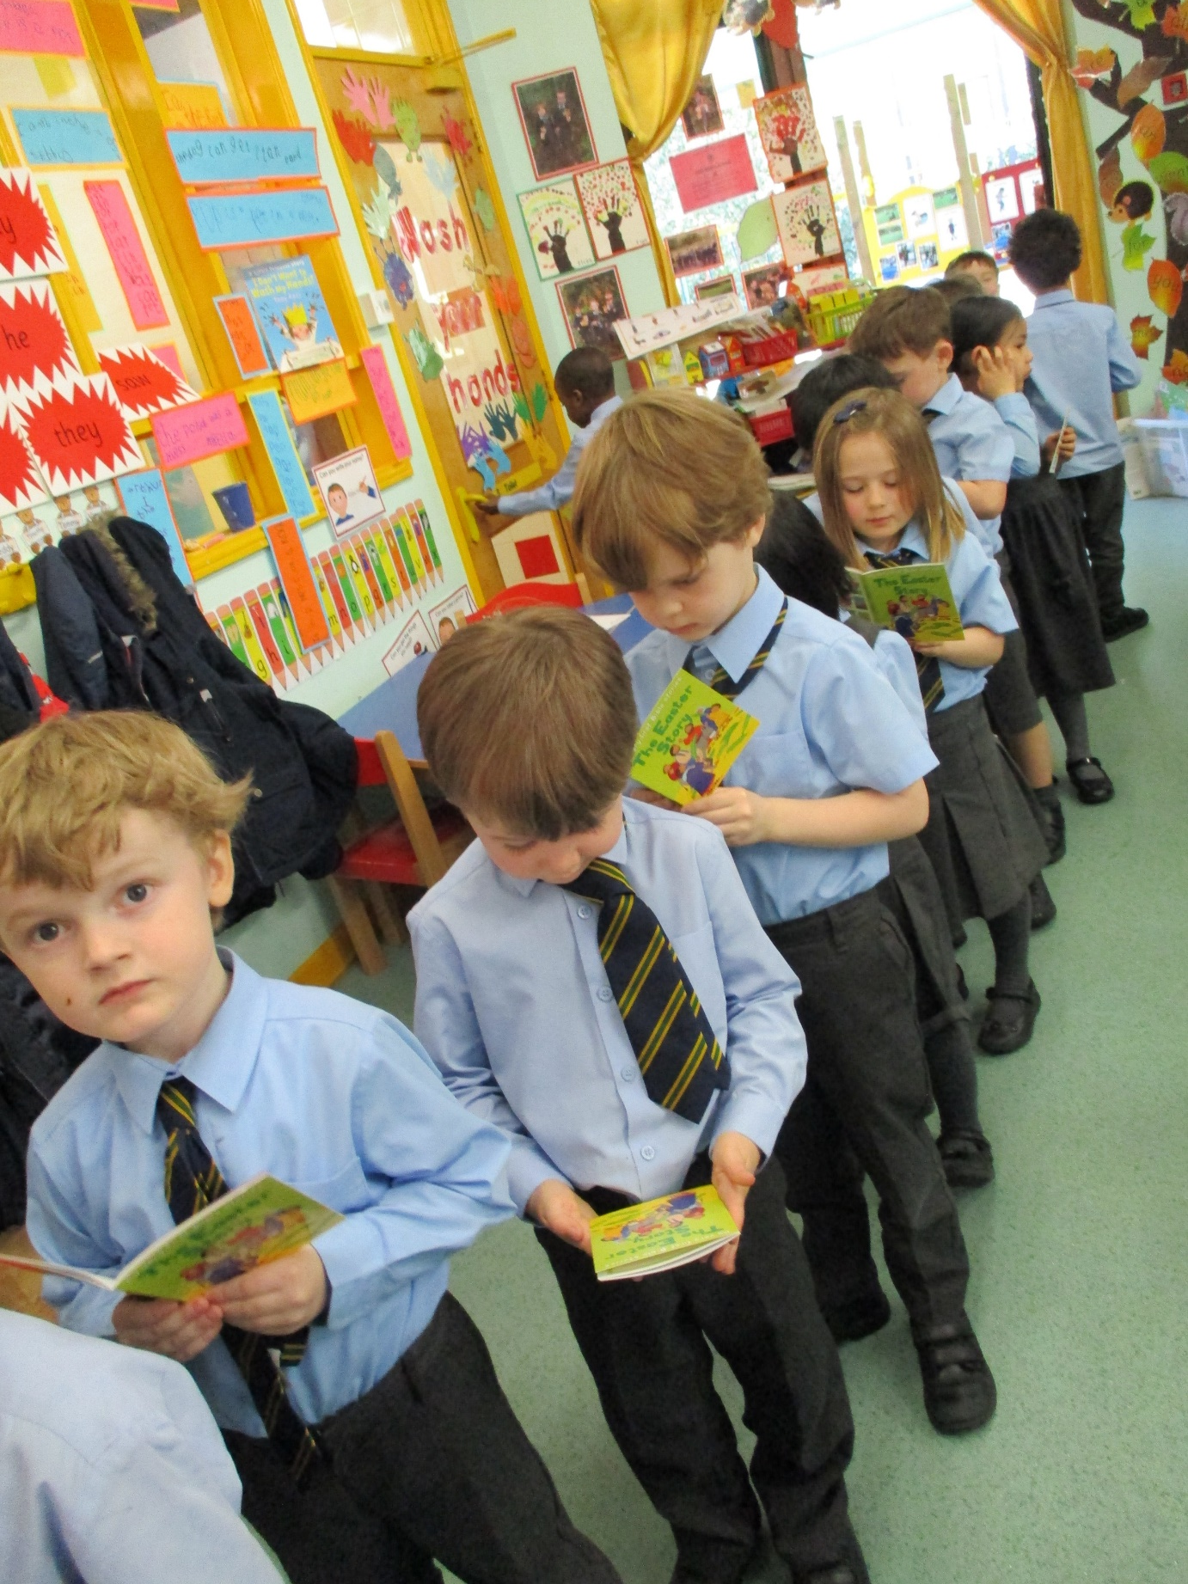
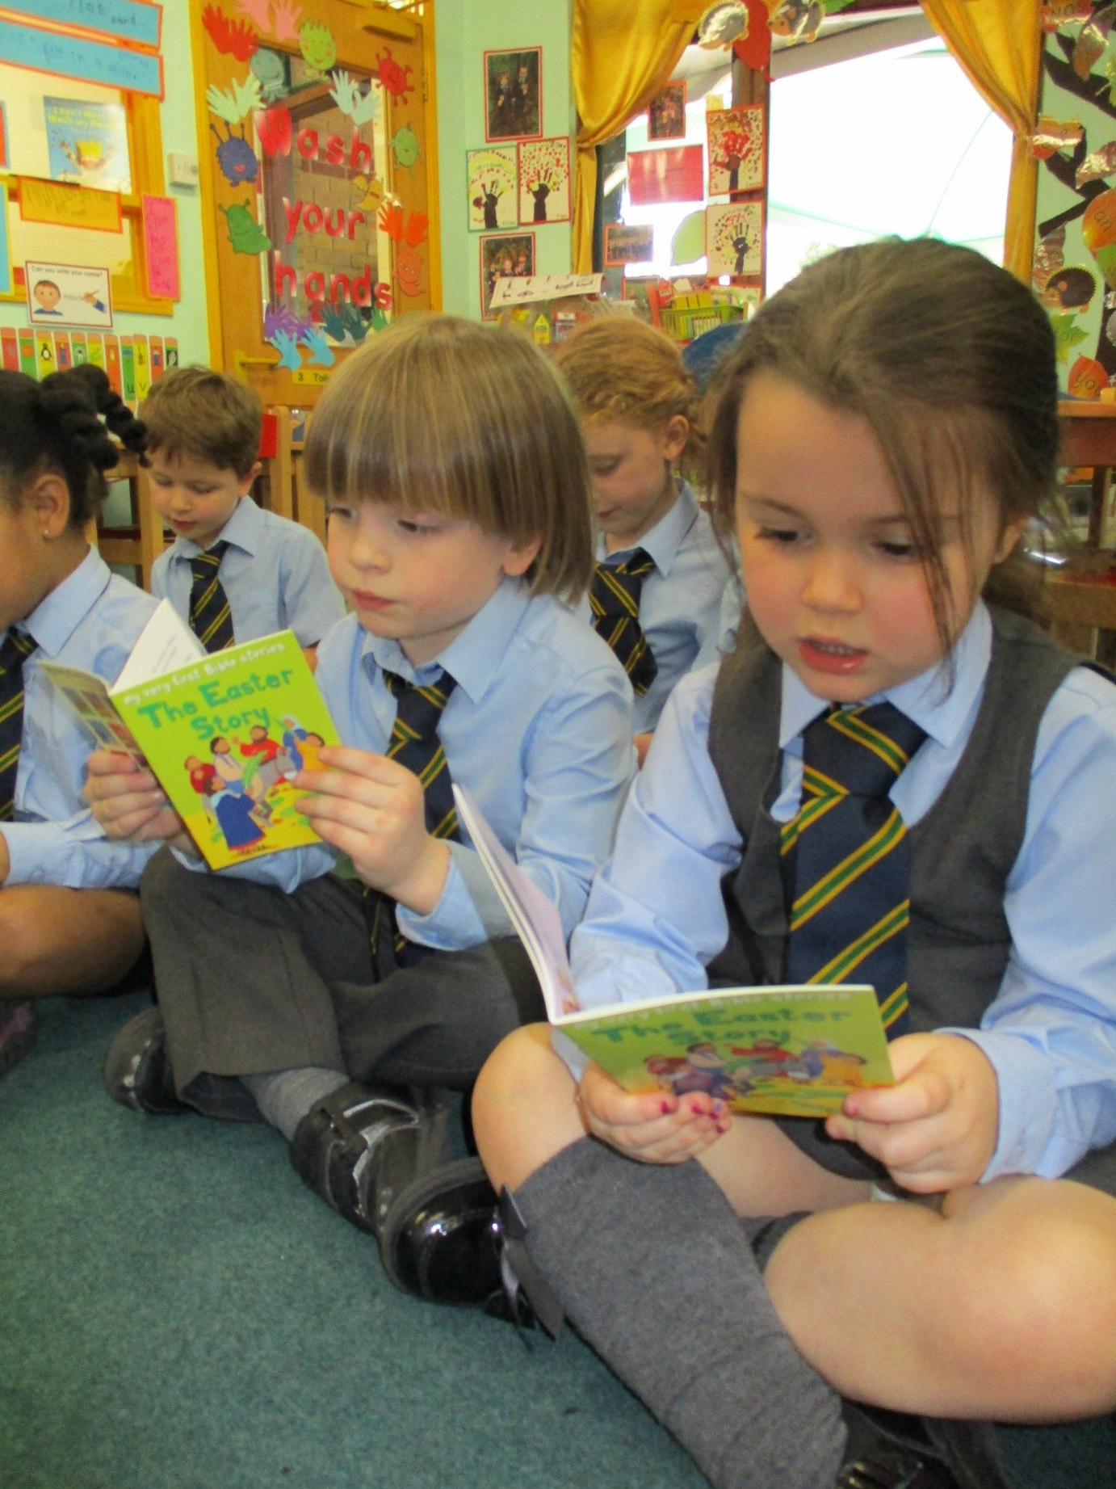
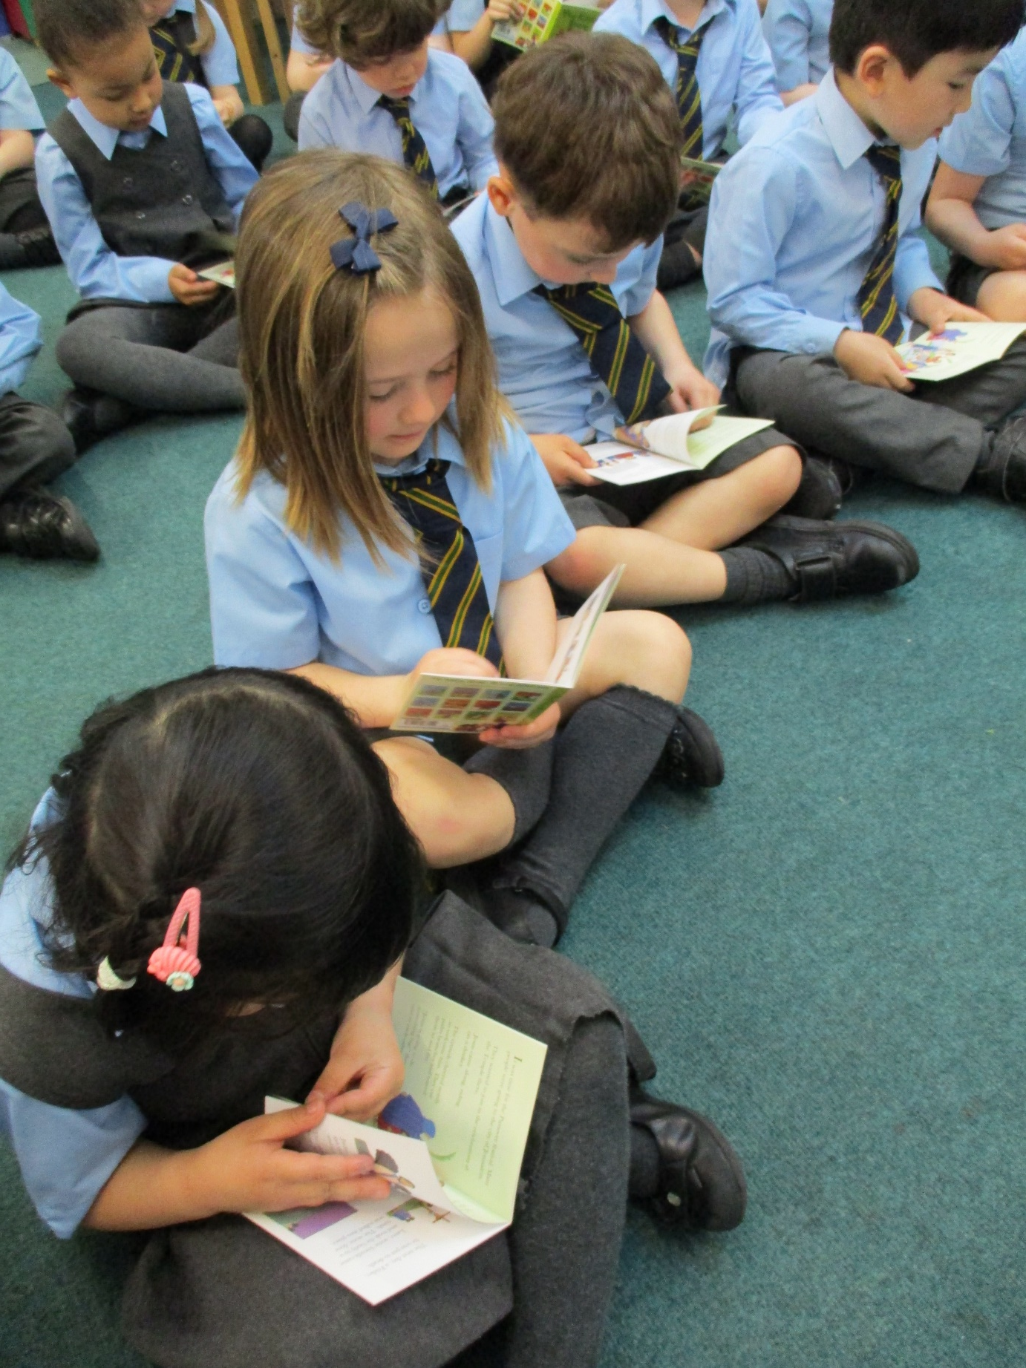
The Easter Story
Each child from Nursery to KS1 received an Easter storybook. They enjoyed looking at these as they visited the trees. These were taken home to be shared with their families.

Slide 8
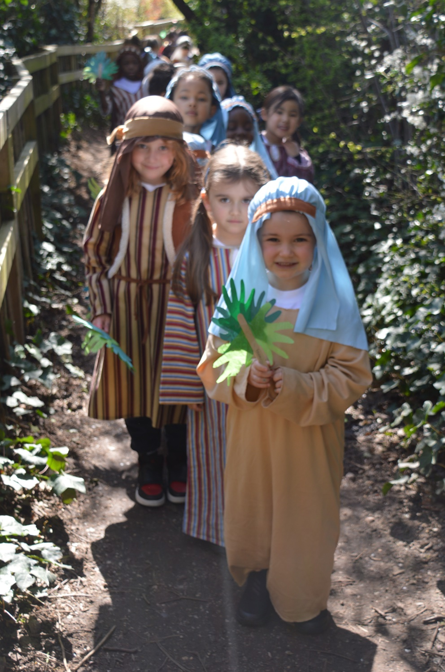
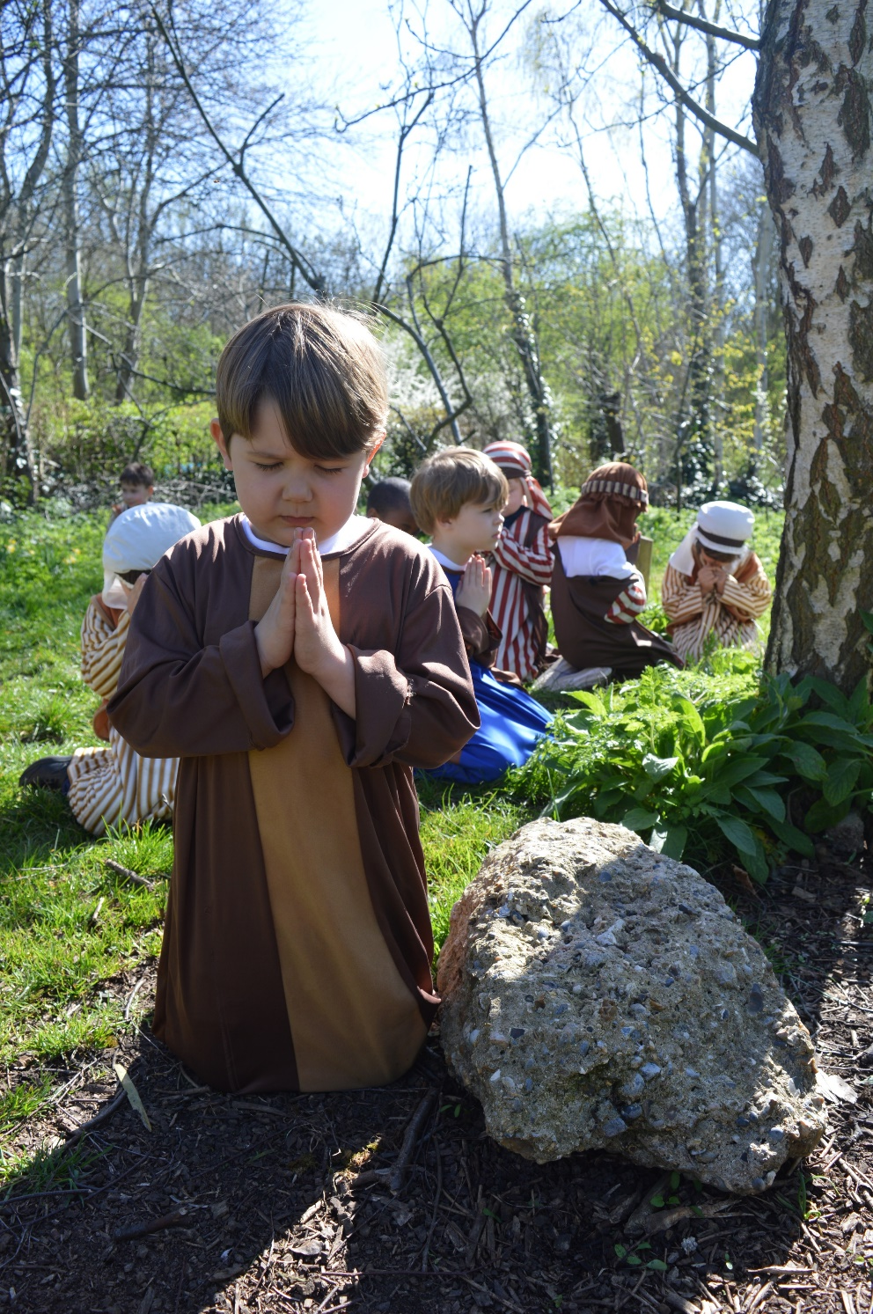
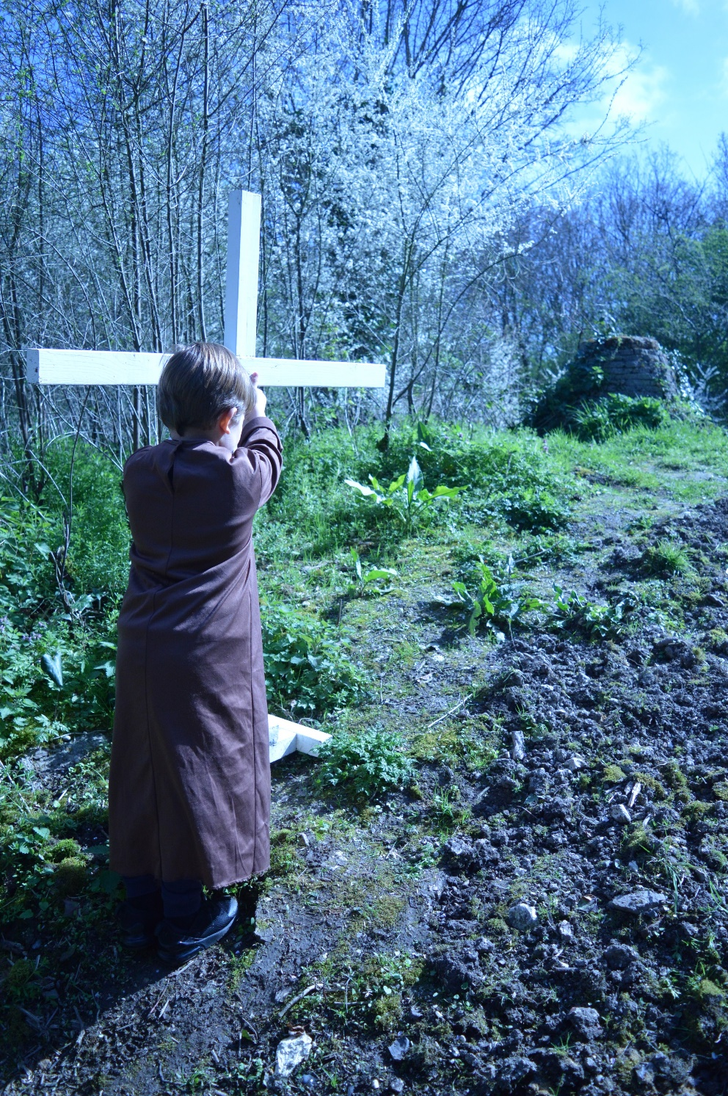
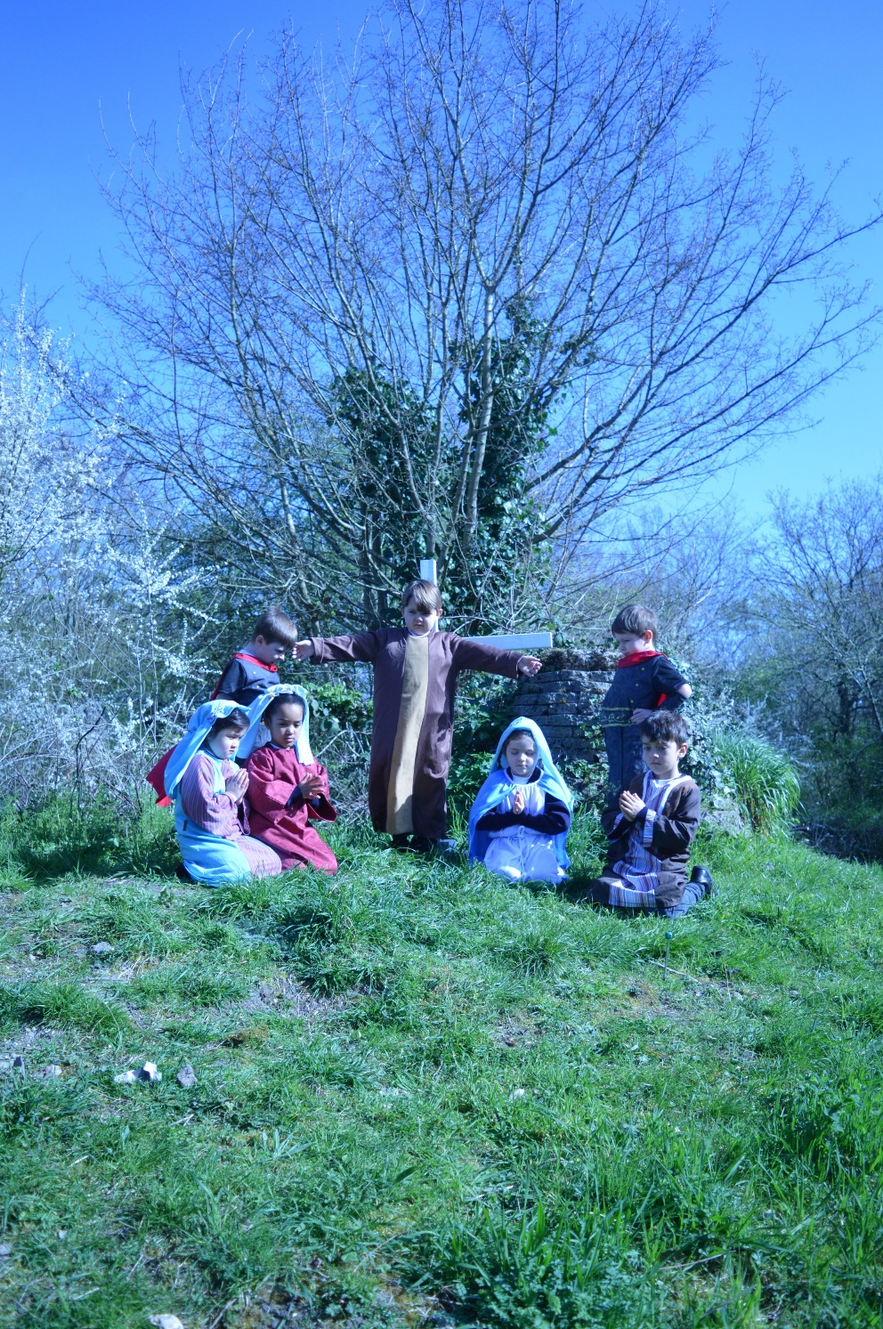
Holy Week
A set of slides in tableau form set to music which depicts the final journey of Jesus performed by Reception Class was shared on our website for children and parents to reflect upon at home.

Slide 9
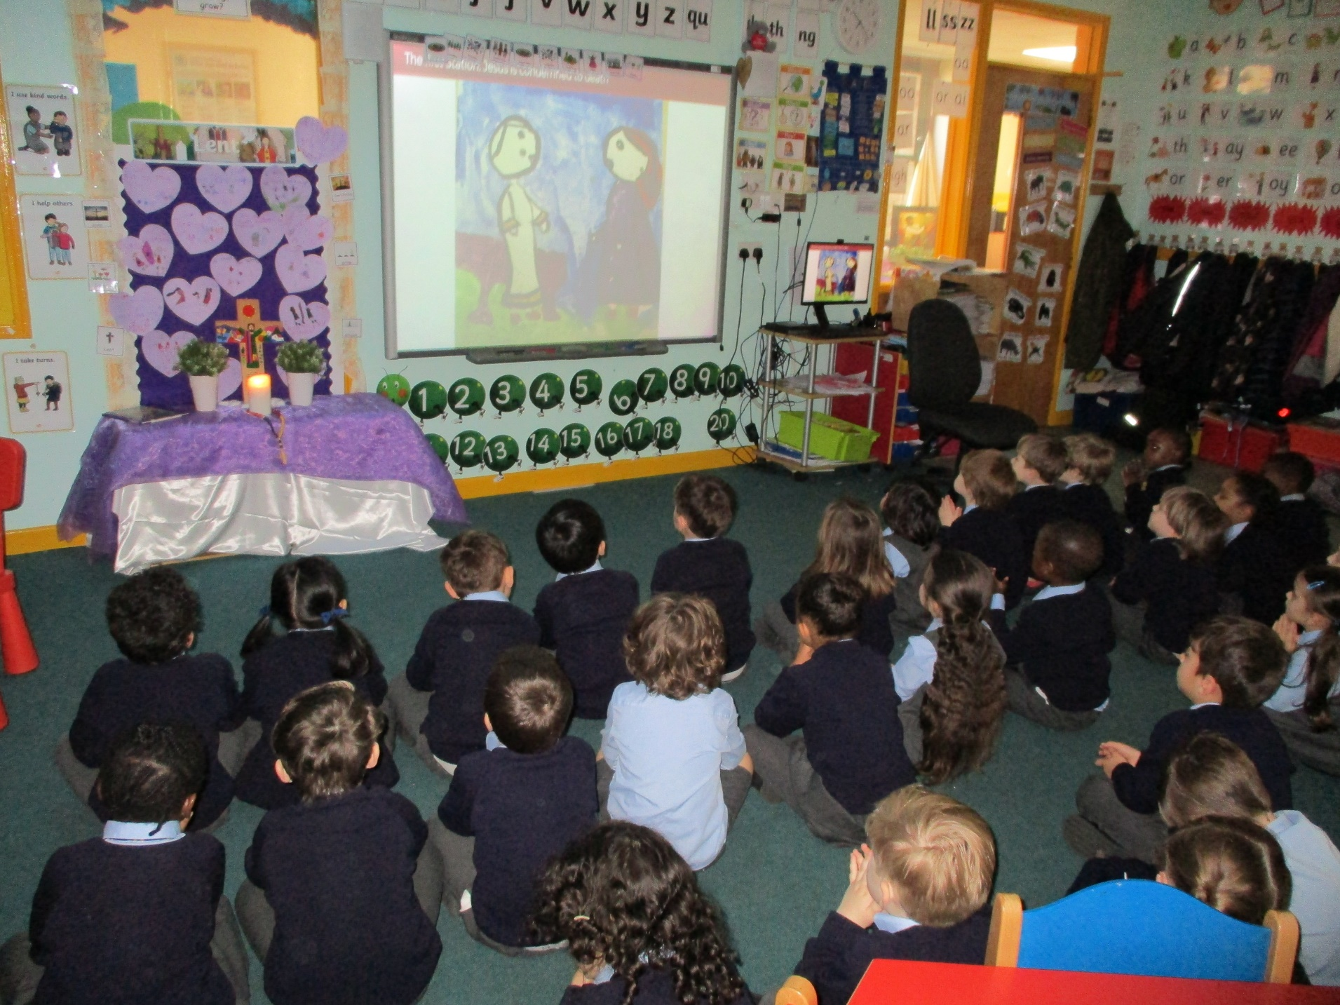
Stations of the Cross
To enable the children to take part in the stations of the cross worship, each class painted pictures of one of the stations and the SLC recorded prayers and responses. These formed part of an assembly led by the head of school via zoom.
This assembly was also uploaded to the school website for families to enjoy at home.

Slide 10
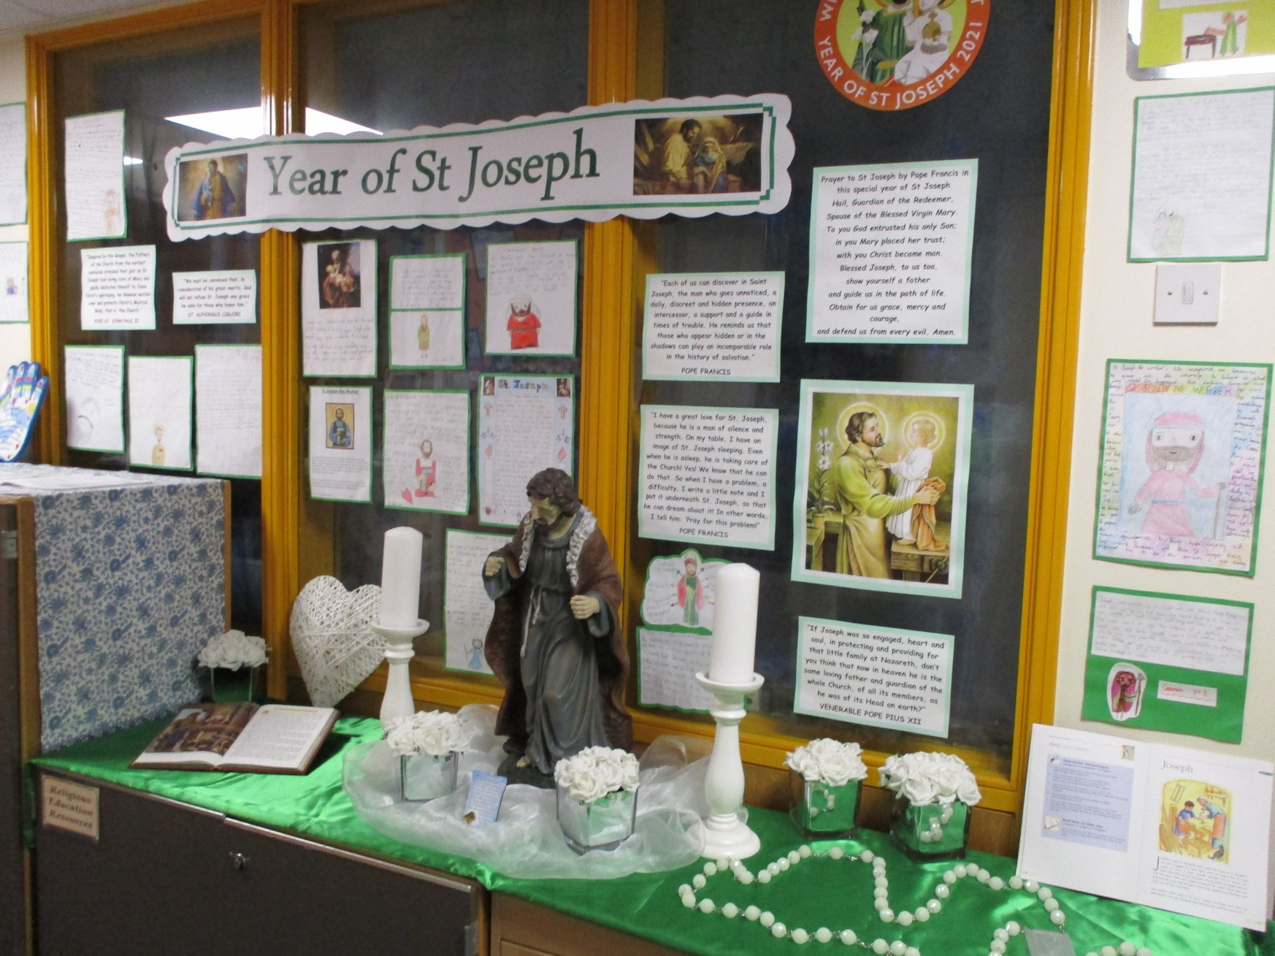
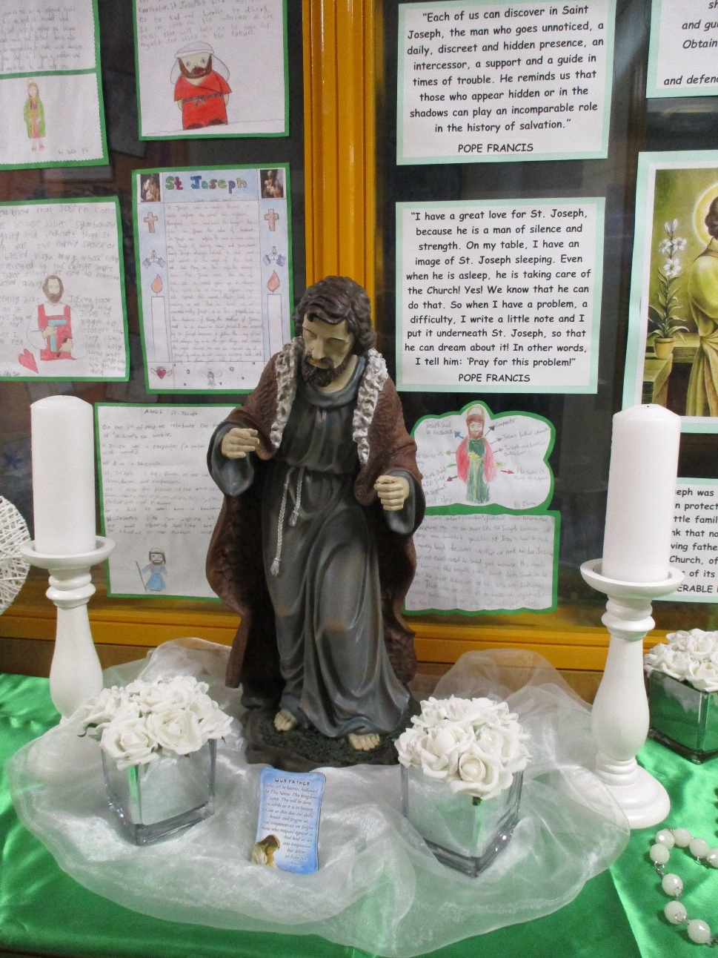
The Year of St Joseph
This Year celebrates the Year of St Joseph. The children in KS2 and their families took part in a homework project to find out about St Joseph the worker and to write how his life can inspire them. The children also had an opportunity to pray with their families to St Joseph using the prayer written by Pope Francis for this special Year. The children’s work is displayed in our school.

Slide 11
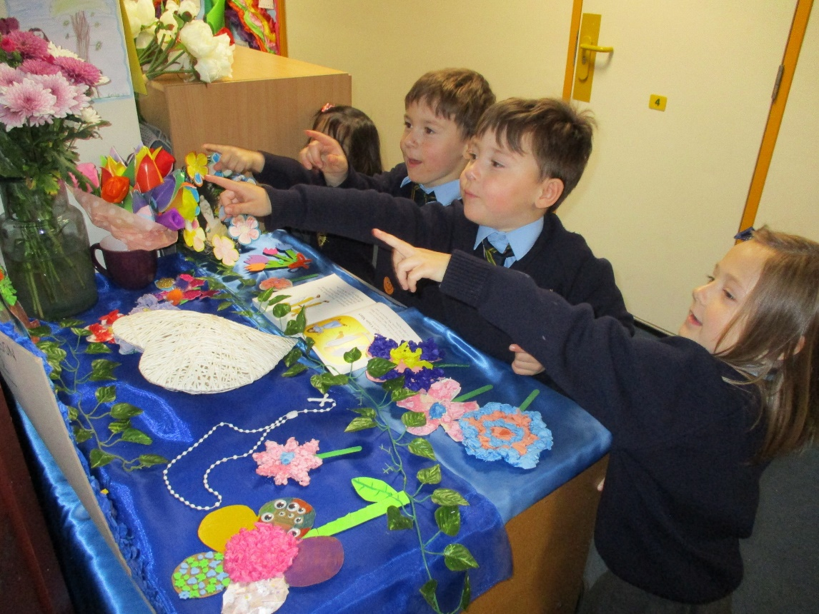
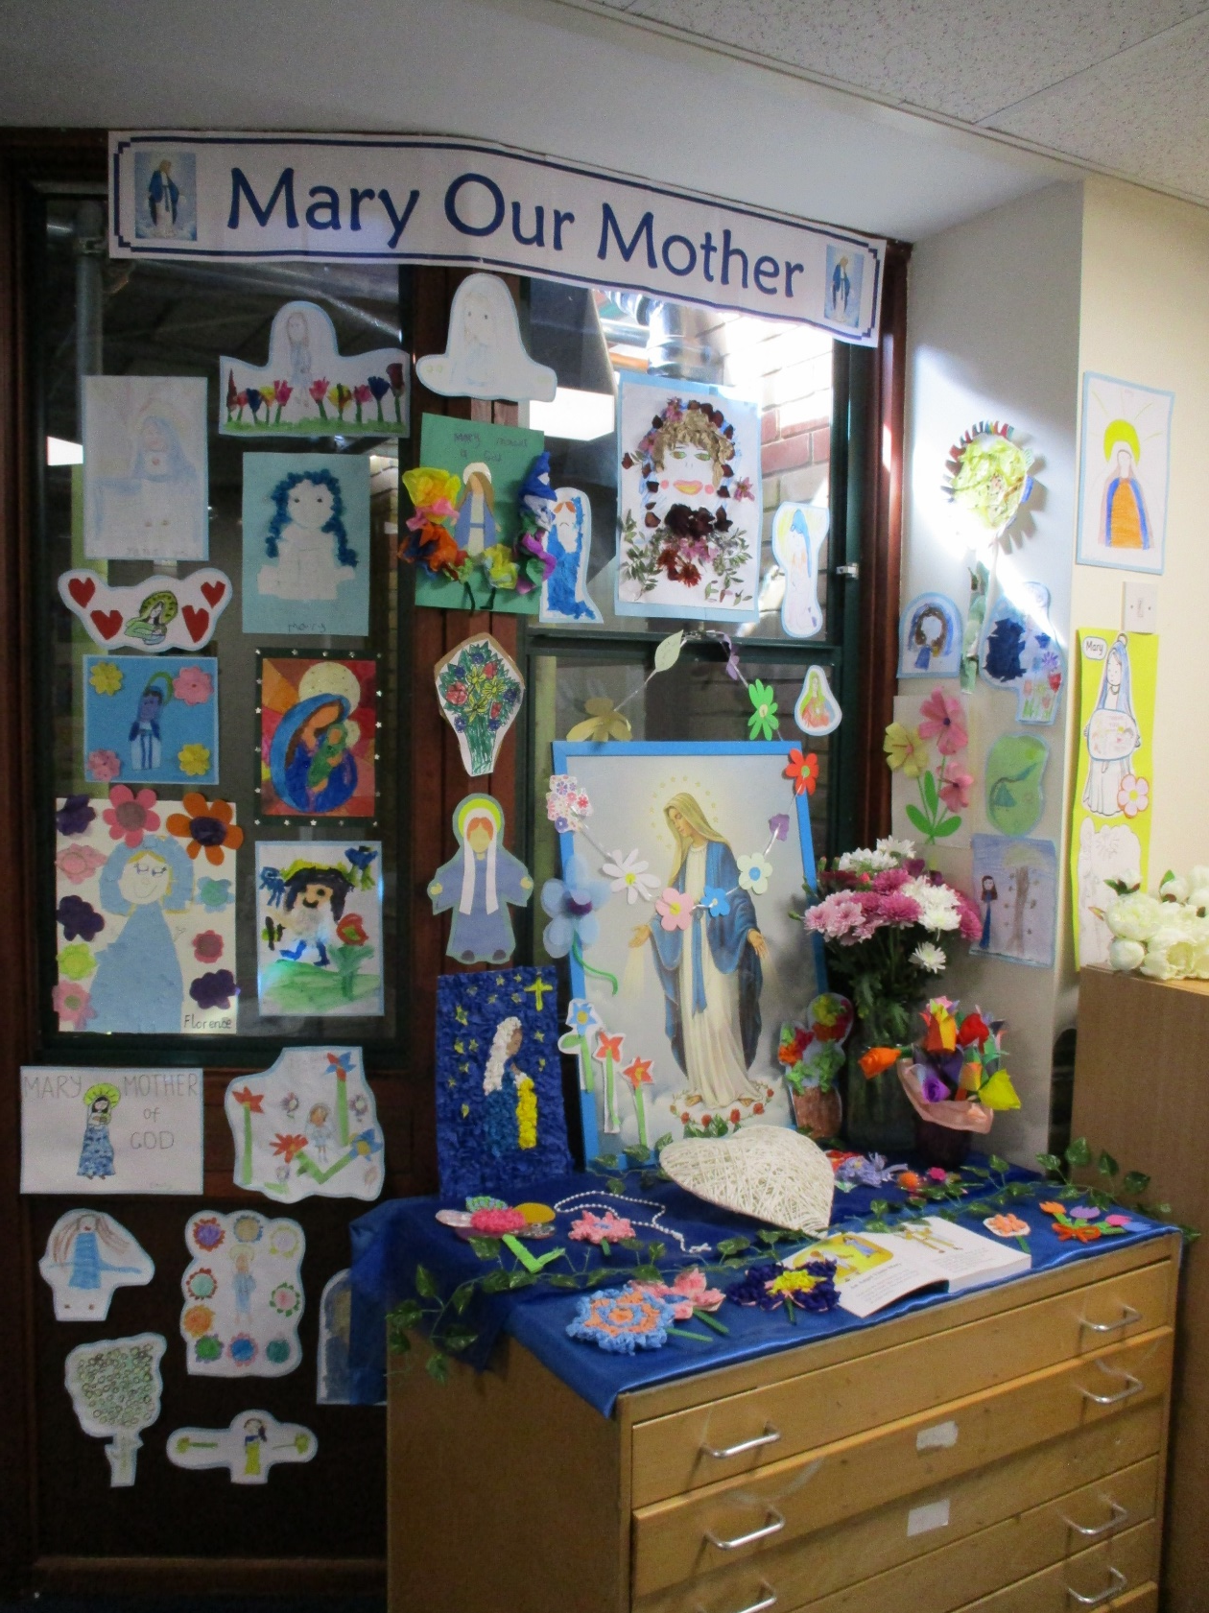
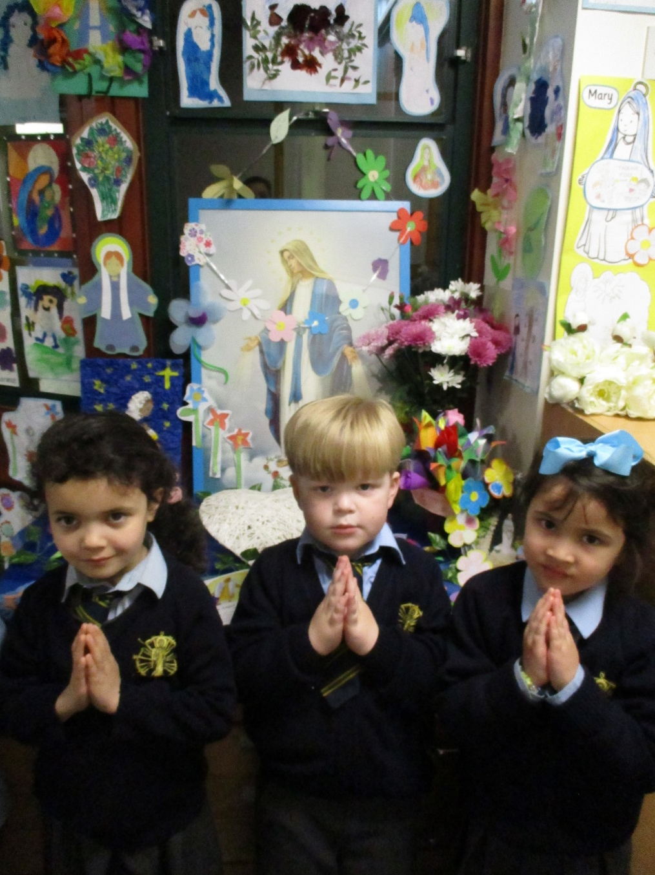
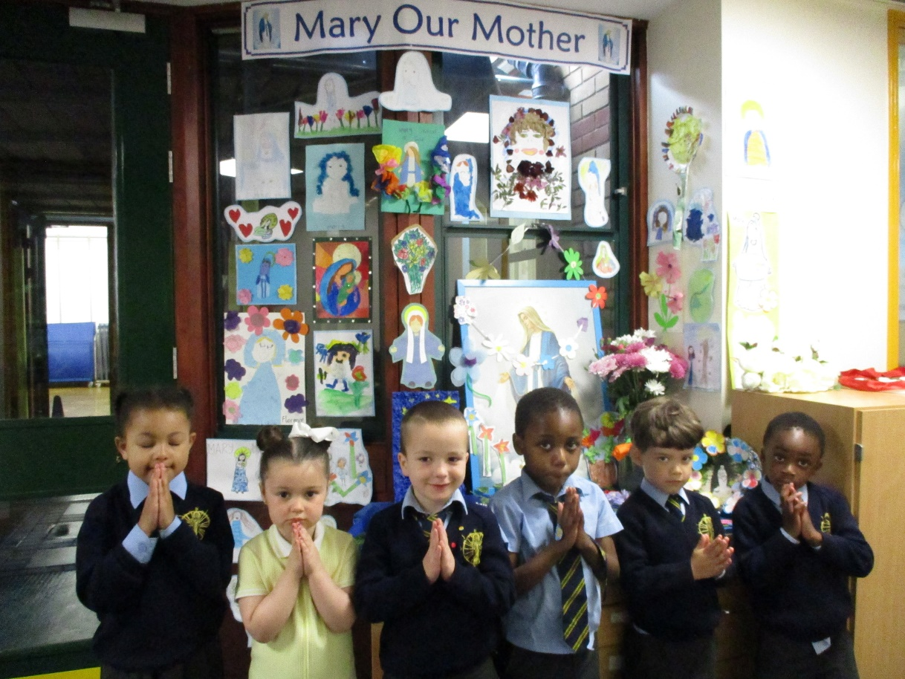
The Month of May
The Month of May is a very special month in our school calendar. To celebrate the month of Mary the children in KS1 were invited to make flowers for Mary and to create pictures of Mary as their RE homework project.

Slide 12
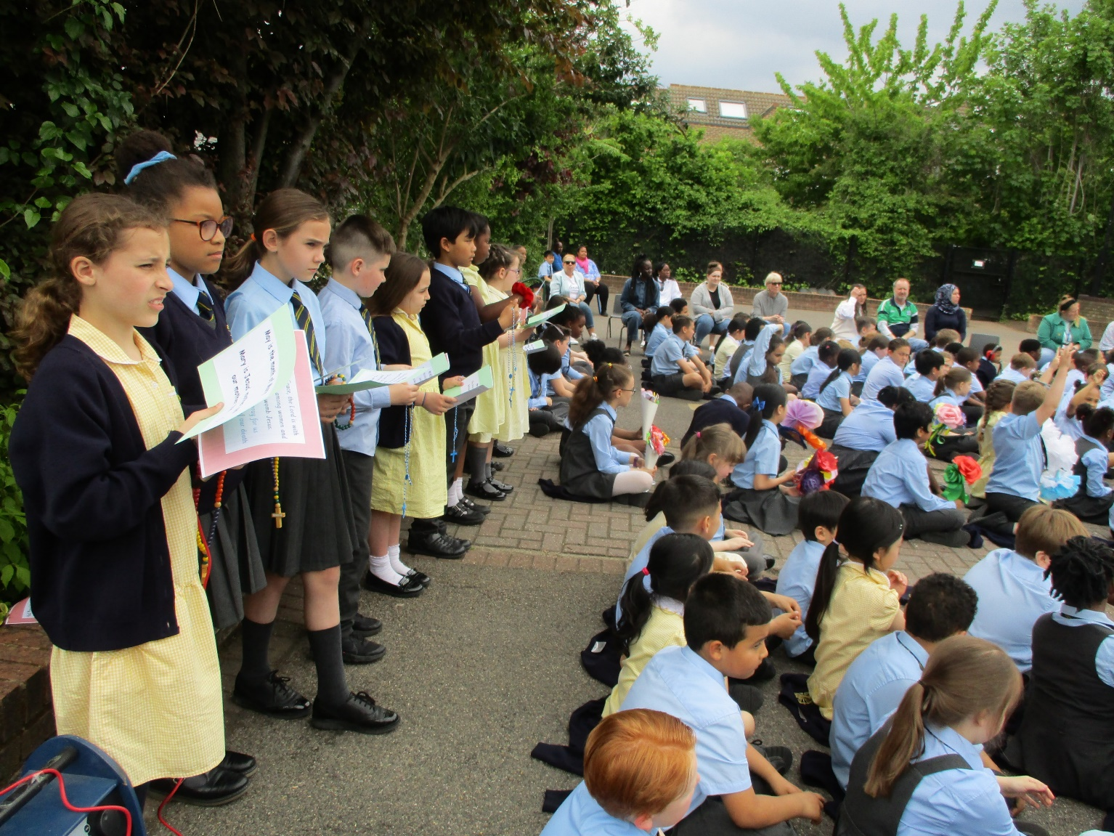
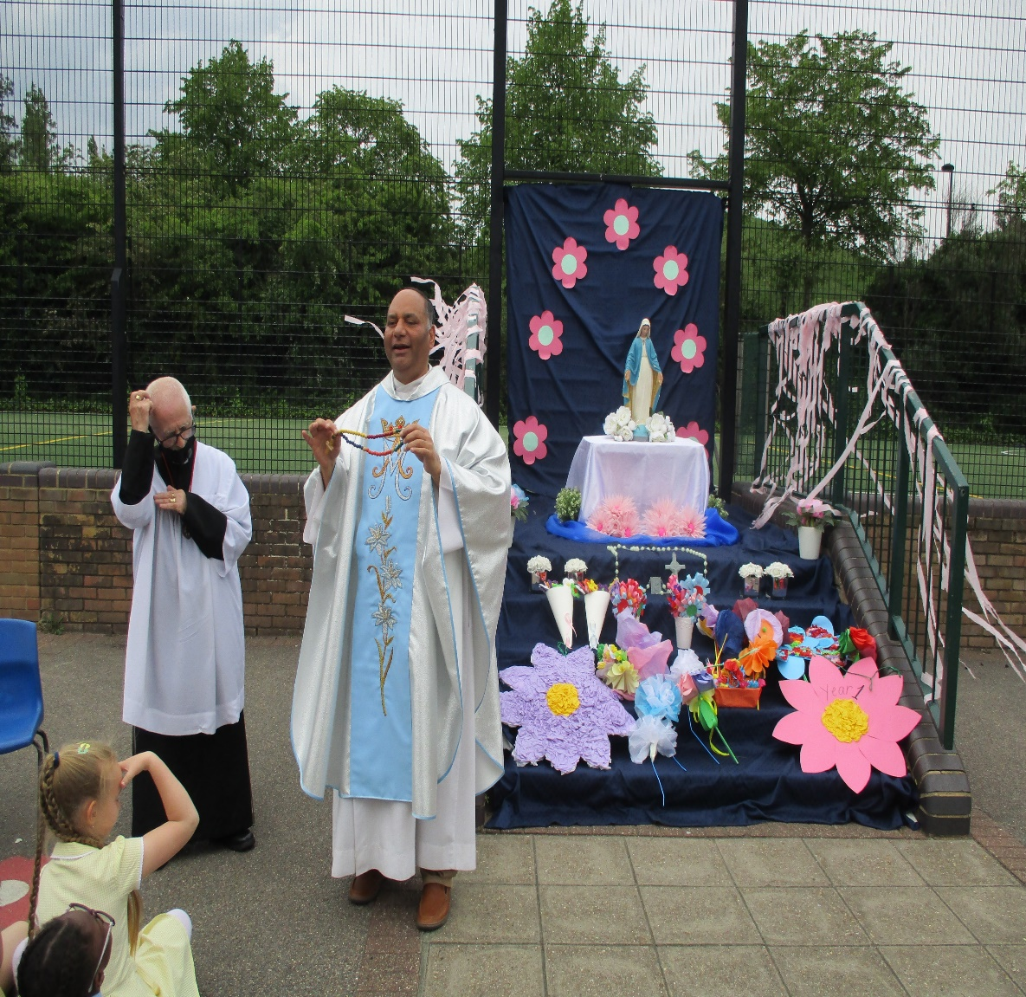
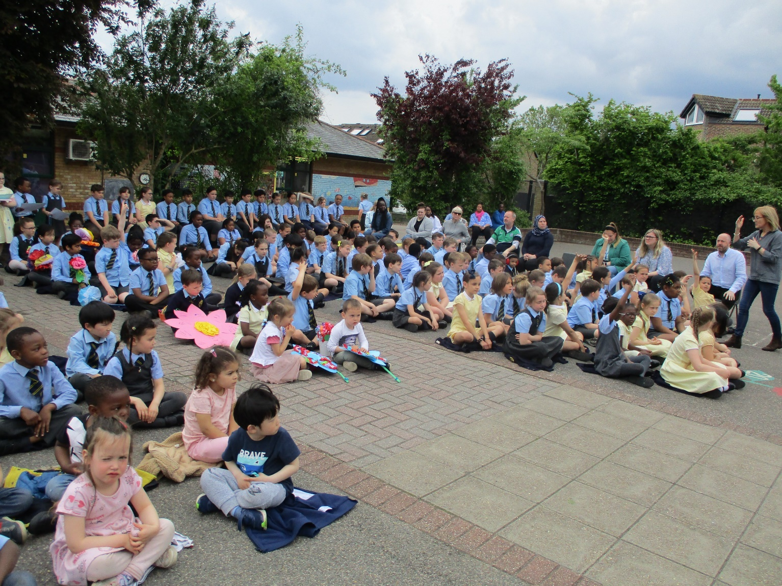
May Celebration
At our annual May Crowning this year, the children led a beautiful litany to the Blessed Virgin Mary and prayed a decade of the rosary.
Two children from each year group presented flowers to the statue of Mary as traditional Marian hymns were sung.
It was lovely to have all the children and Father Azad worshipping outside in the sunshine together.

Slide 13
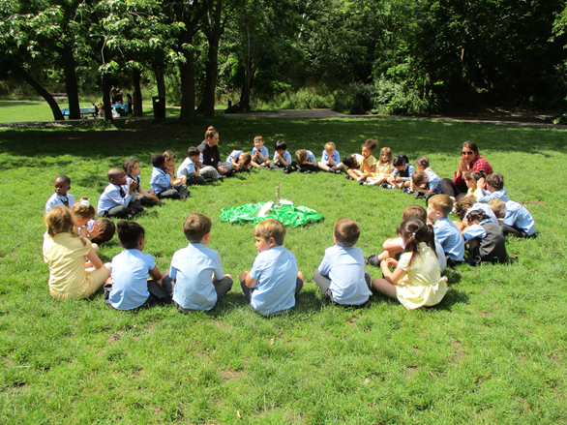
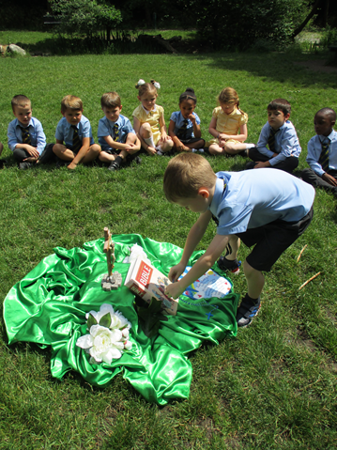
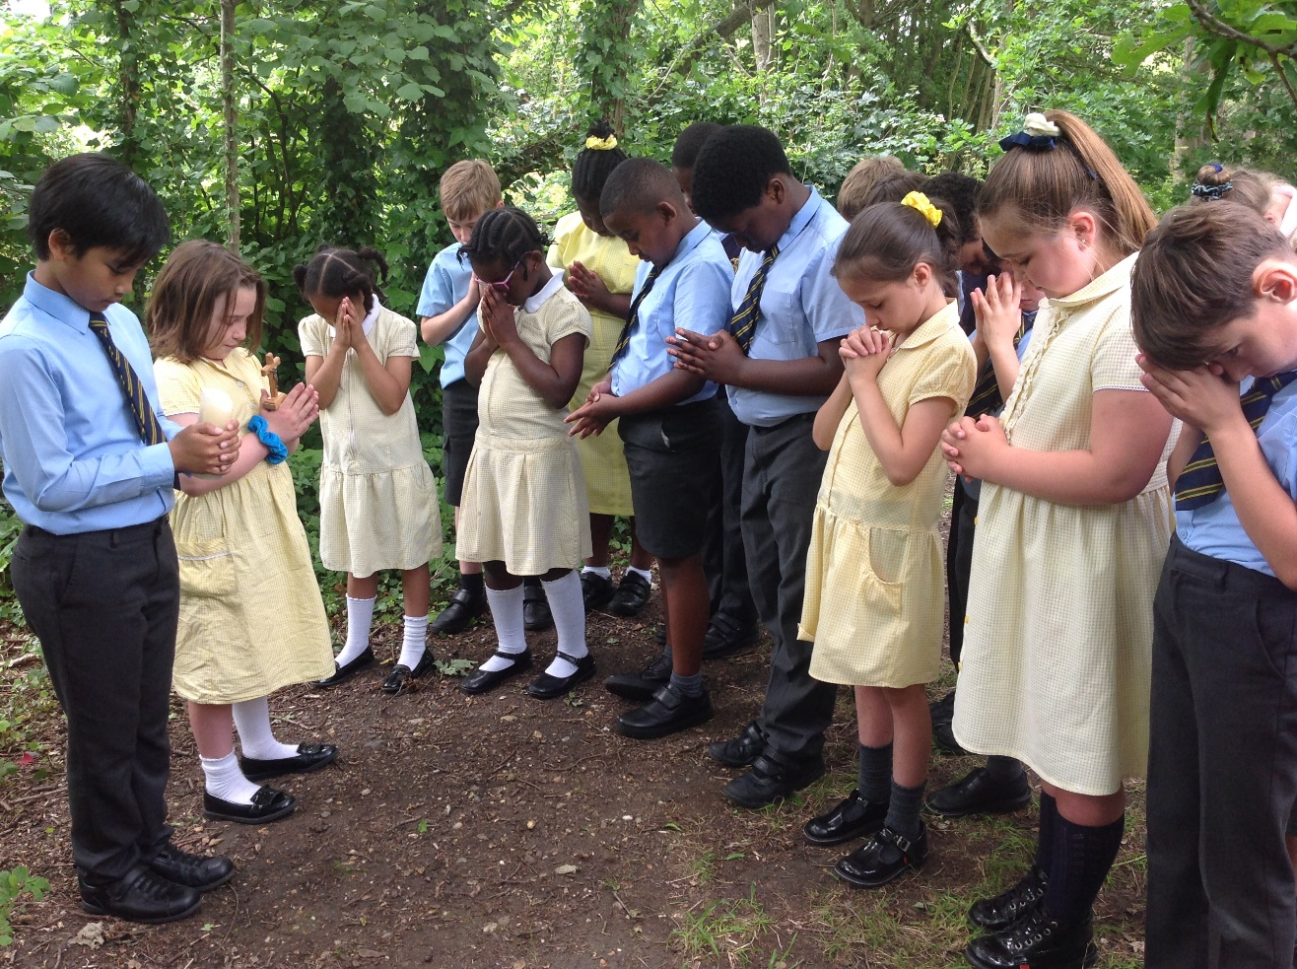
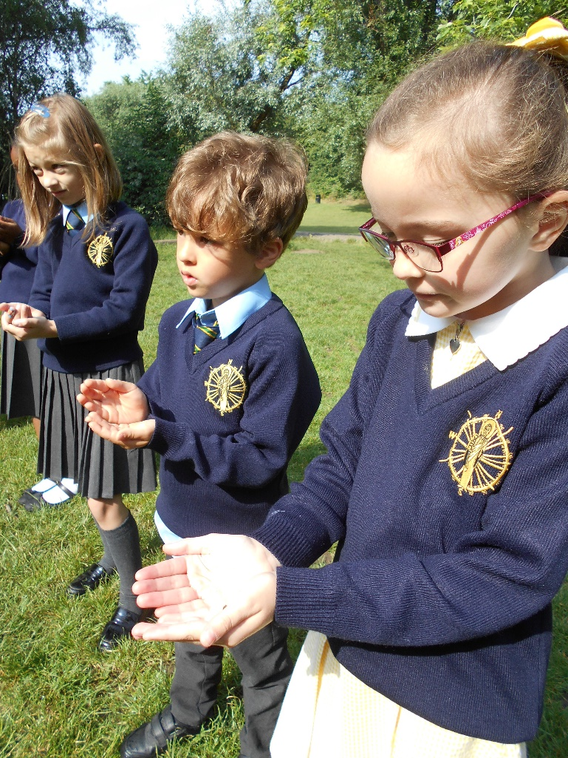
Prayer and Reflection in the Woodlands Week
All the classes took part in the thanksgiving prayer sessions in the Woodlands. The children had the opportunity to admire nature and thanked God for the beauty of his creation.
It was an amazing experience for all the children. They could feel the presence of God in everything around them.
”Thank you God for the grass we are sitting on and all the birds that sing to us in the morning.” Said Sofia (Year 2) and all the birds in the trees started singing.
Year 4 children saw a butterfly in the woodlands. Frankie said , “When you see a butterfly, it means someone you know, who has passed, has come down from Heaven to say hello”.

Slide 14
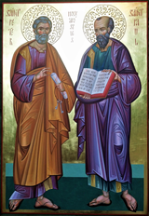
The Feast Day of St Peter and St Paul.
On 29th June the Church celebrates the feast day of Peter and Paul. Their personal backgrounds and individual lives were very different. What joined them was their love of Jesus.
Find out about these two great saints. Think about how their faith showed others what it was like to be a follower of Jesus.
Paul was a good letter writer, so he was given the job of telling people about Jesus. Paul travelled to many countries, such as Crete and Italy. He also wrote to people in other countries, such as Greece. His talent was telling people about God.
Write a letter which tells people what being a follower of Jesus means for you and your family.

Slide 15
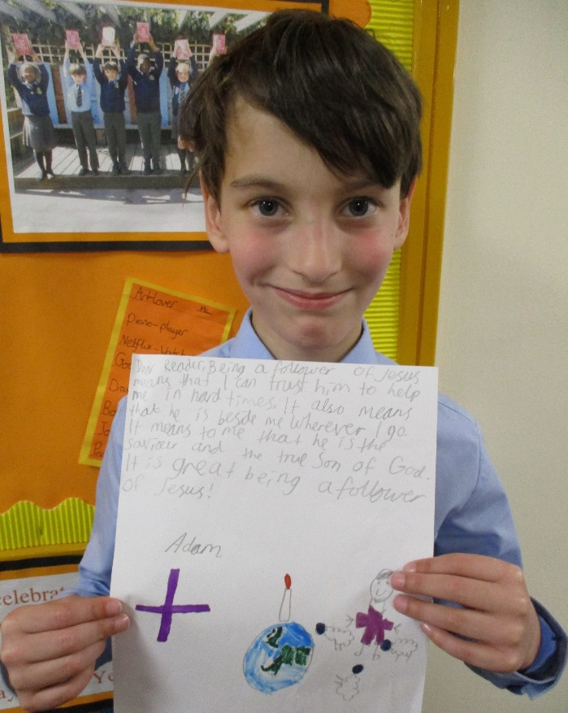
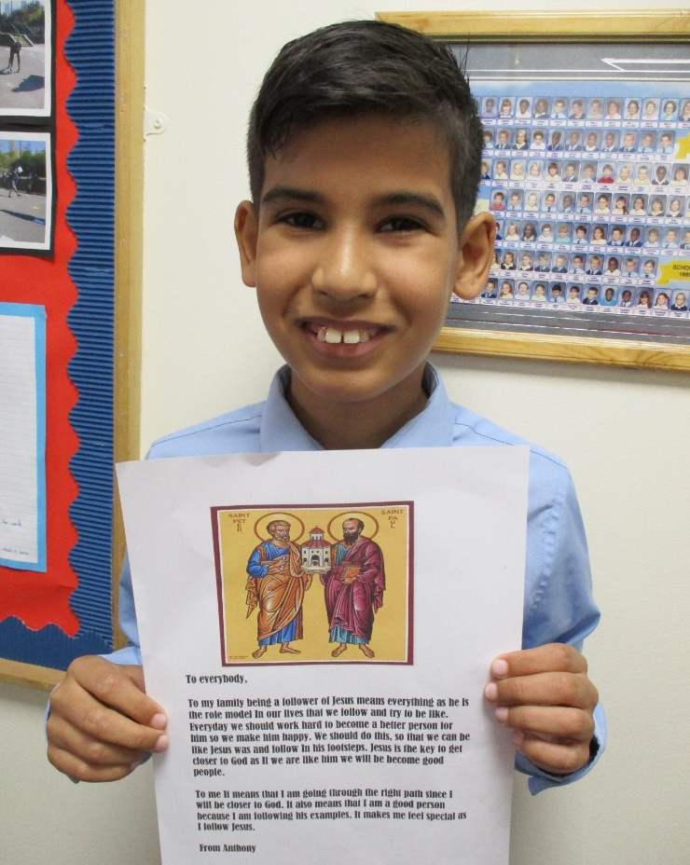
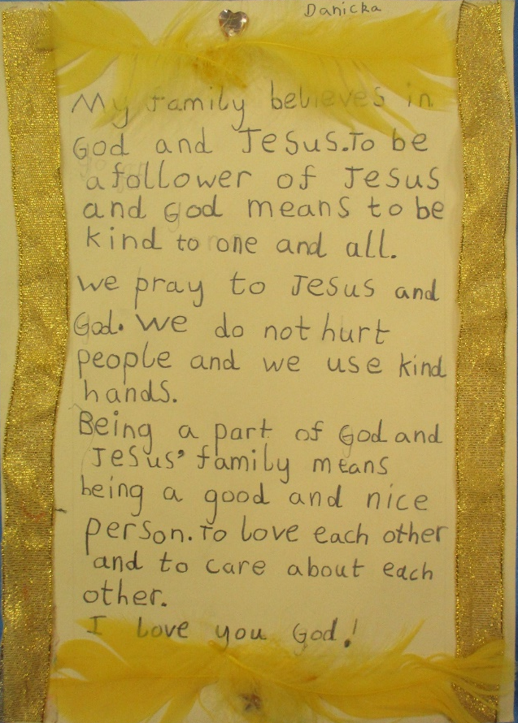
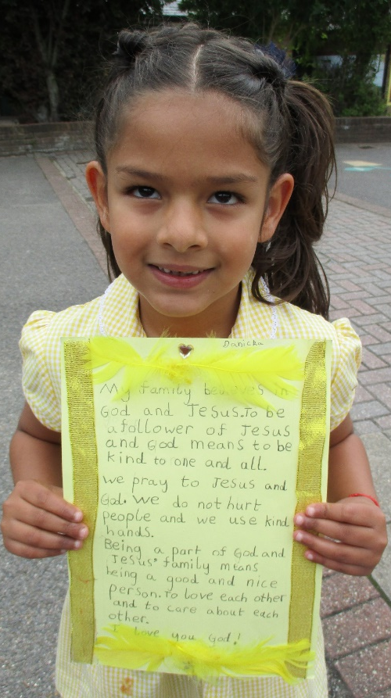
Fr Azad led our school community in Zoom Mass to celebrate the feast day of St Peter & Paul. We are very lucky to be able to join with the parish community in this way. Parents supported their children with the homework project.

Slide 16
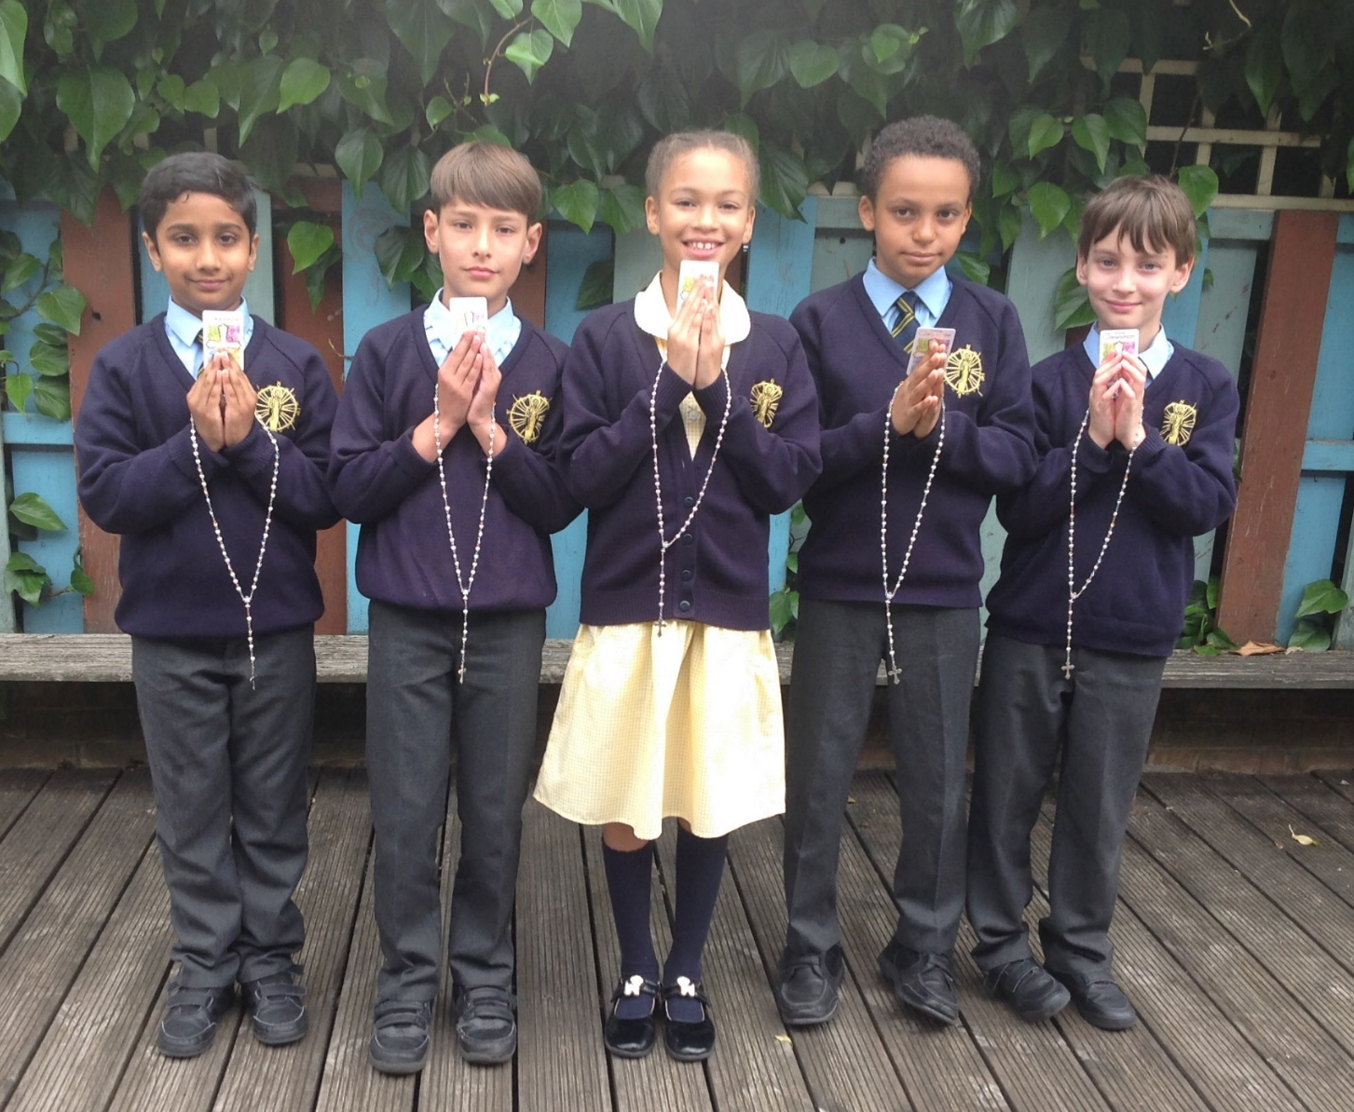
First Holy Communion
Congratulations to those in our school community who made their First Holy Communion. Congratulations also to the families of these children who have been very patient in helping their children prepare for this important event in their Catholic life.
We remember them all in our prayers.

Slide 17
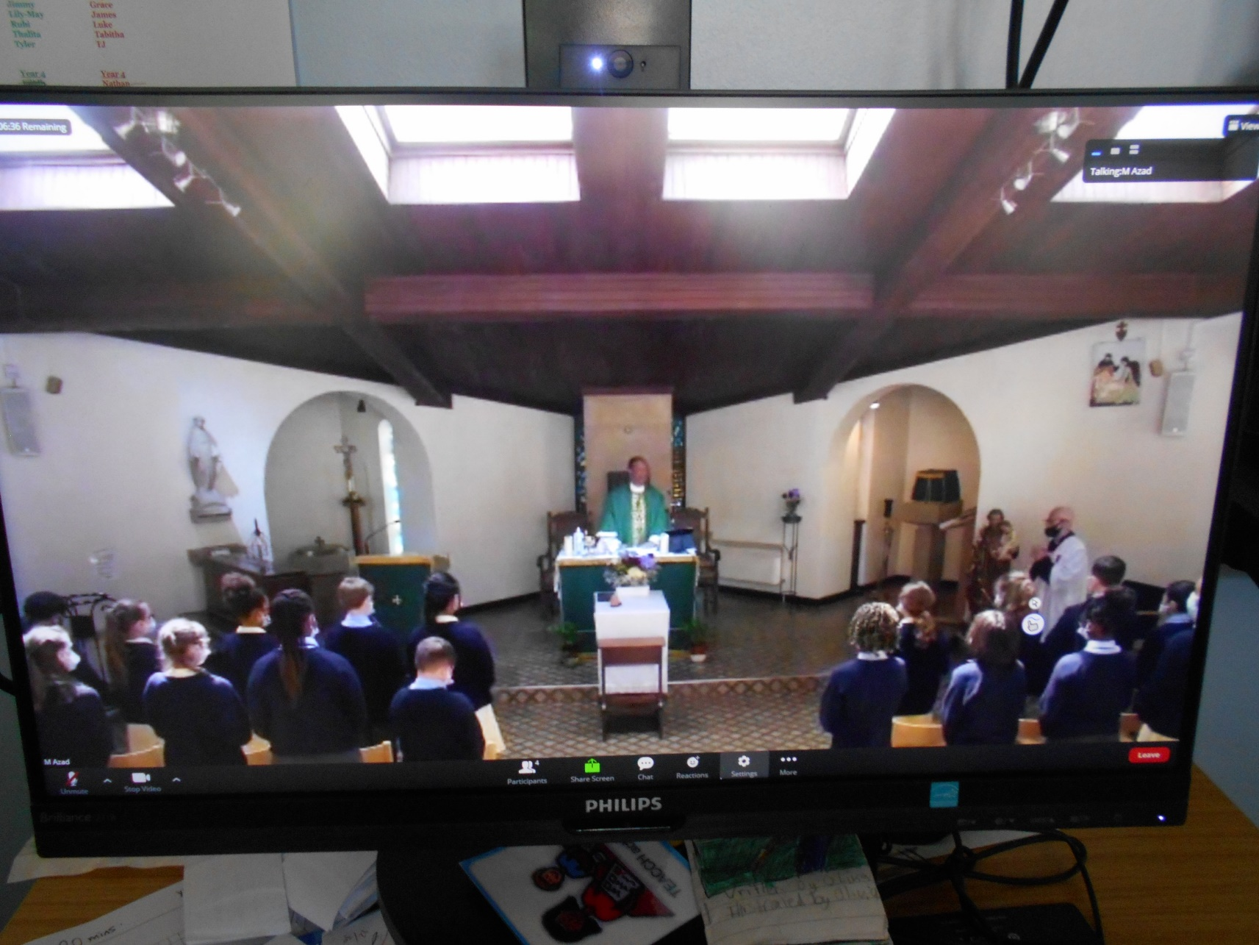
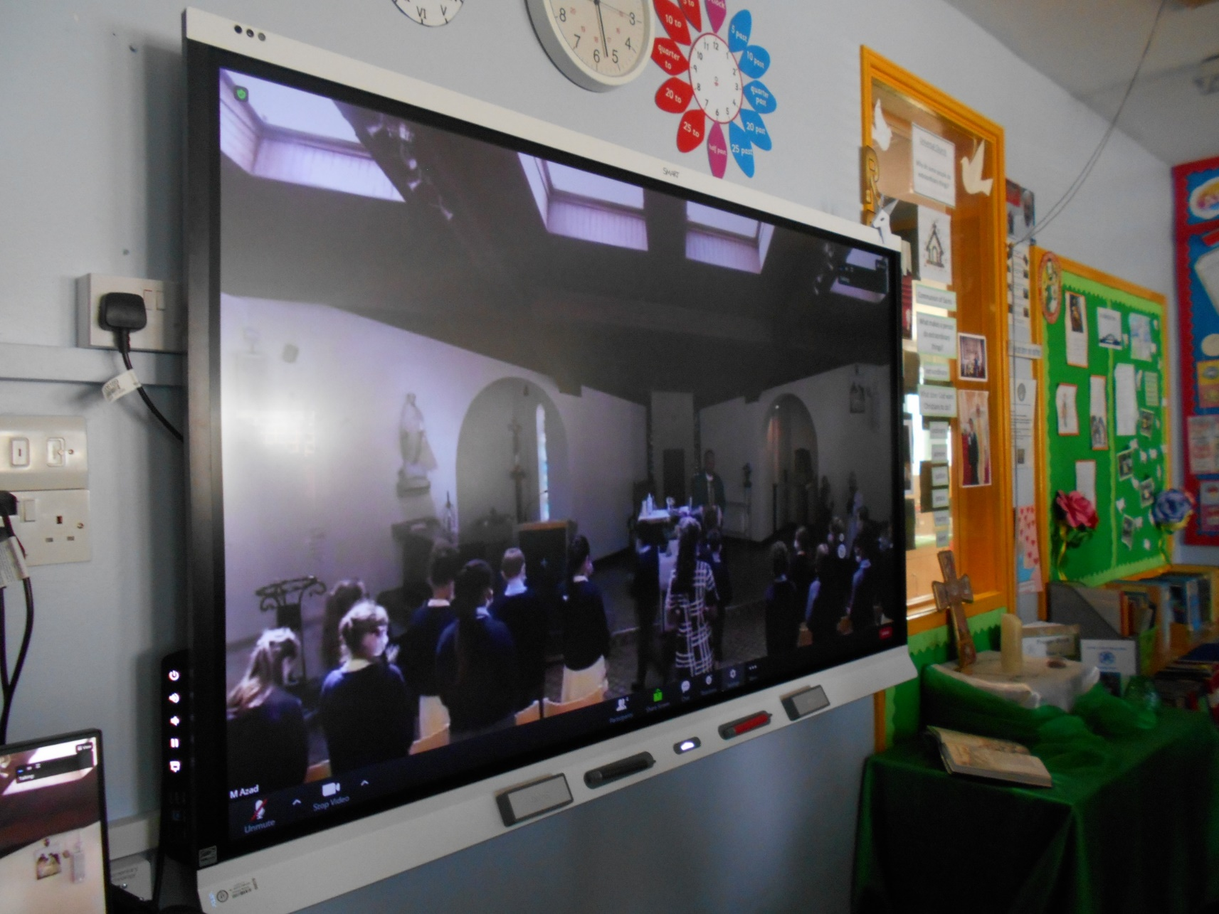
Year 6 Leavers Mass
Years 5, 4 and 3 were able to share in this celebration due to the power of Zoom!

